Slide 1
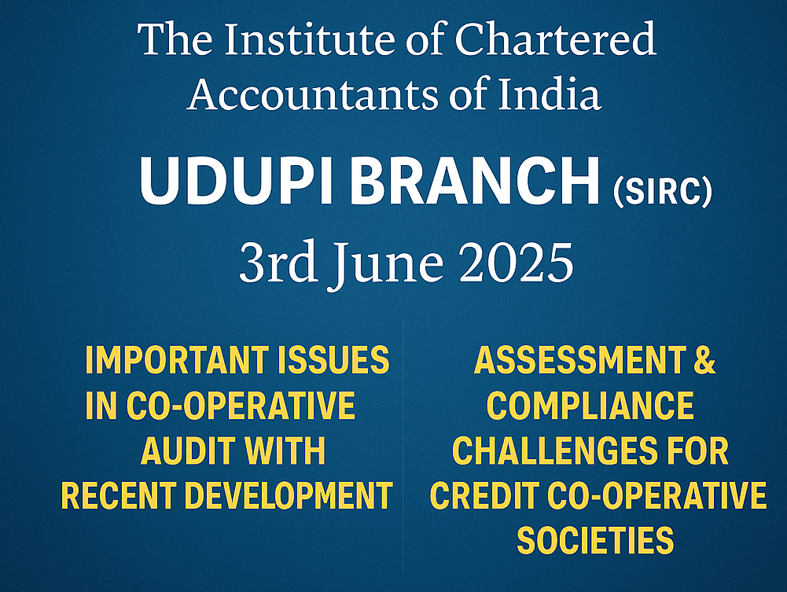

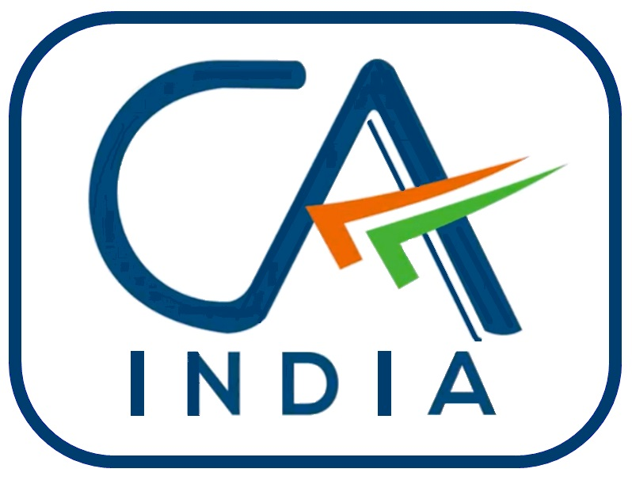

Slide 2
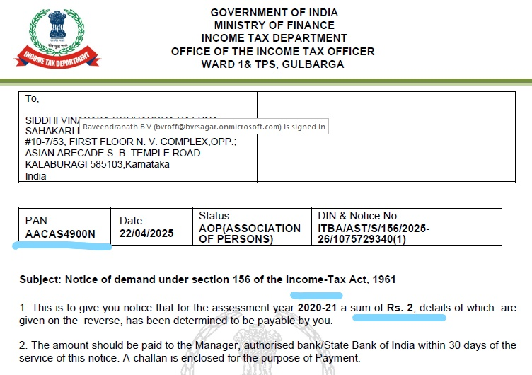
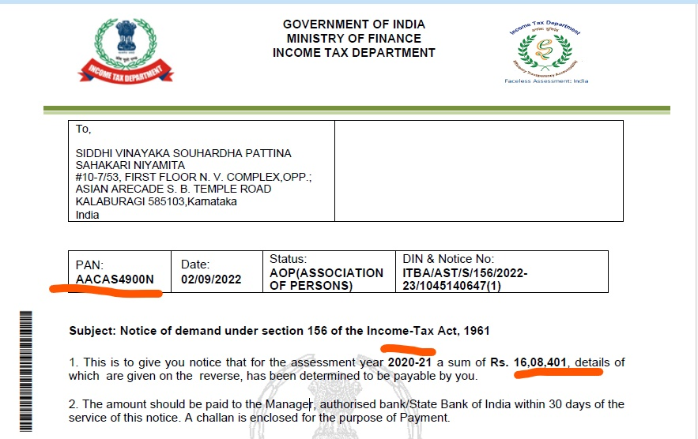

Slide 3
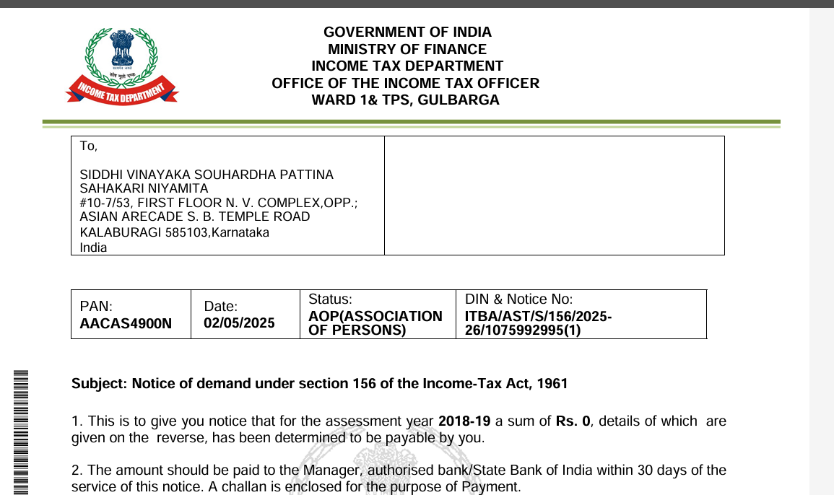
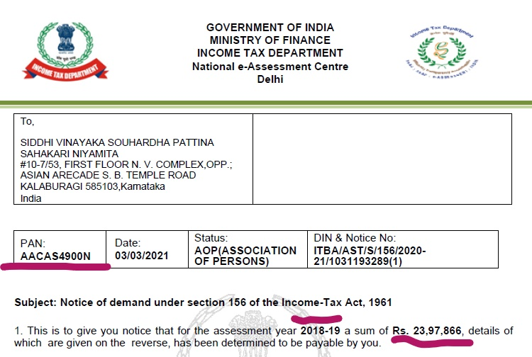

Slide 4
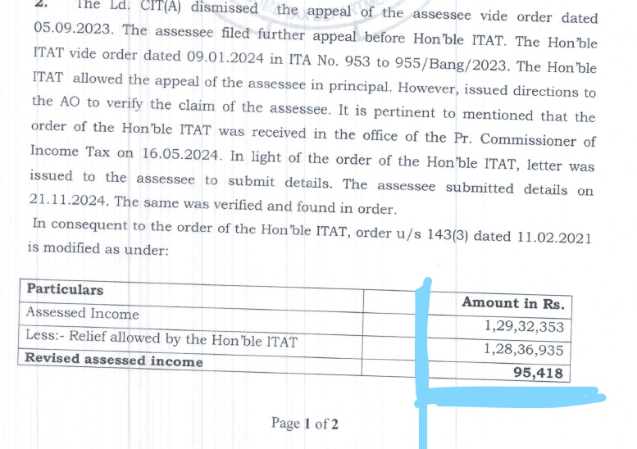

Slide 5
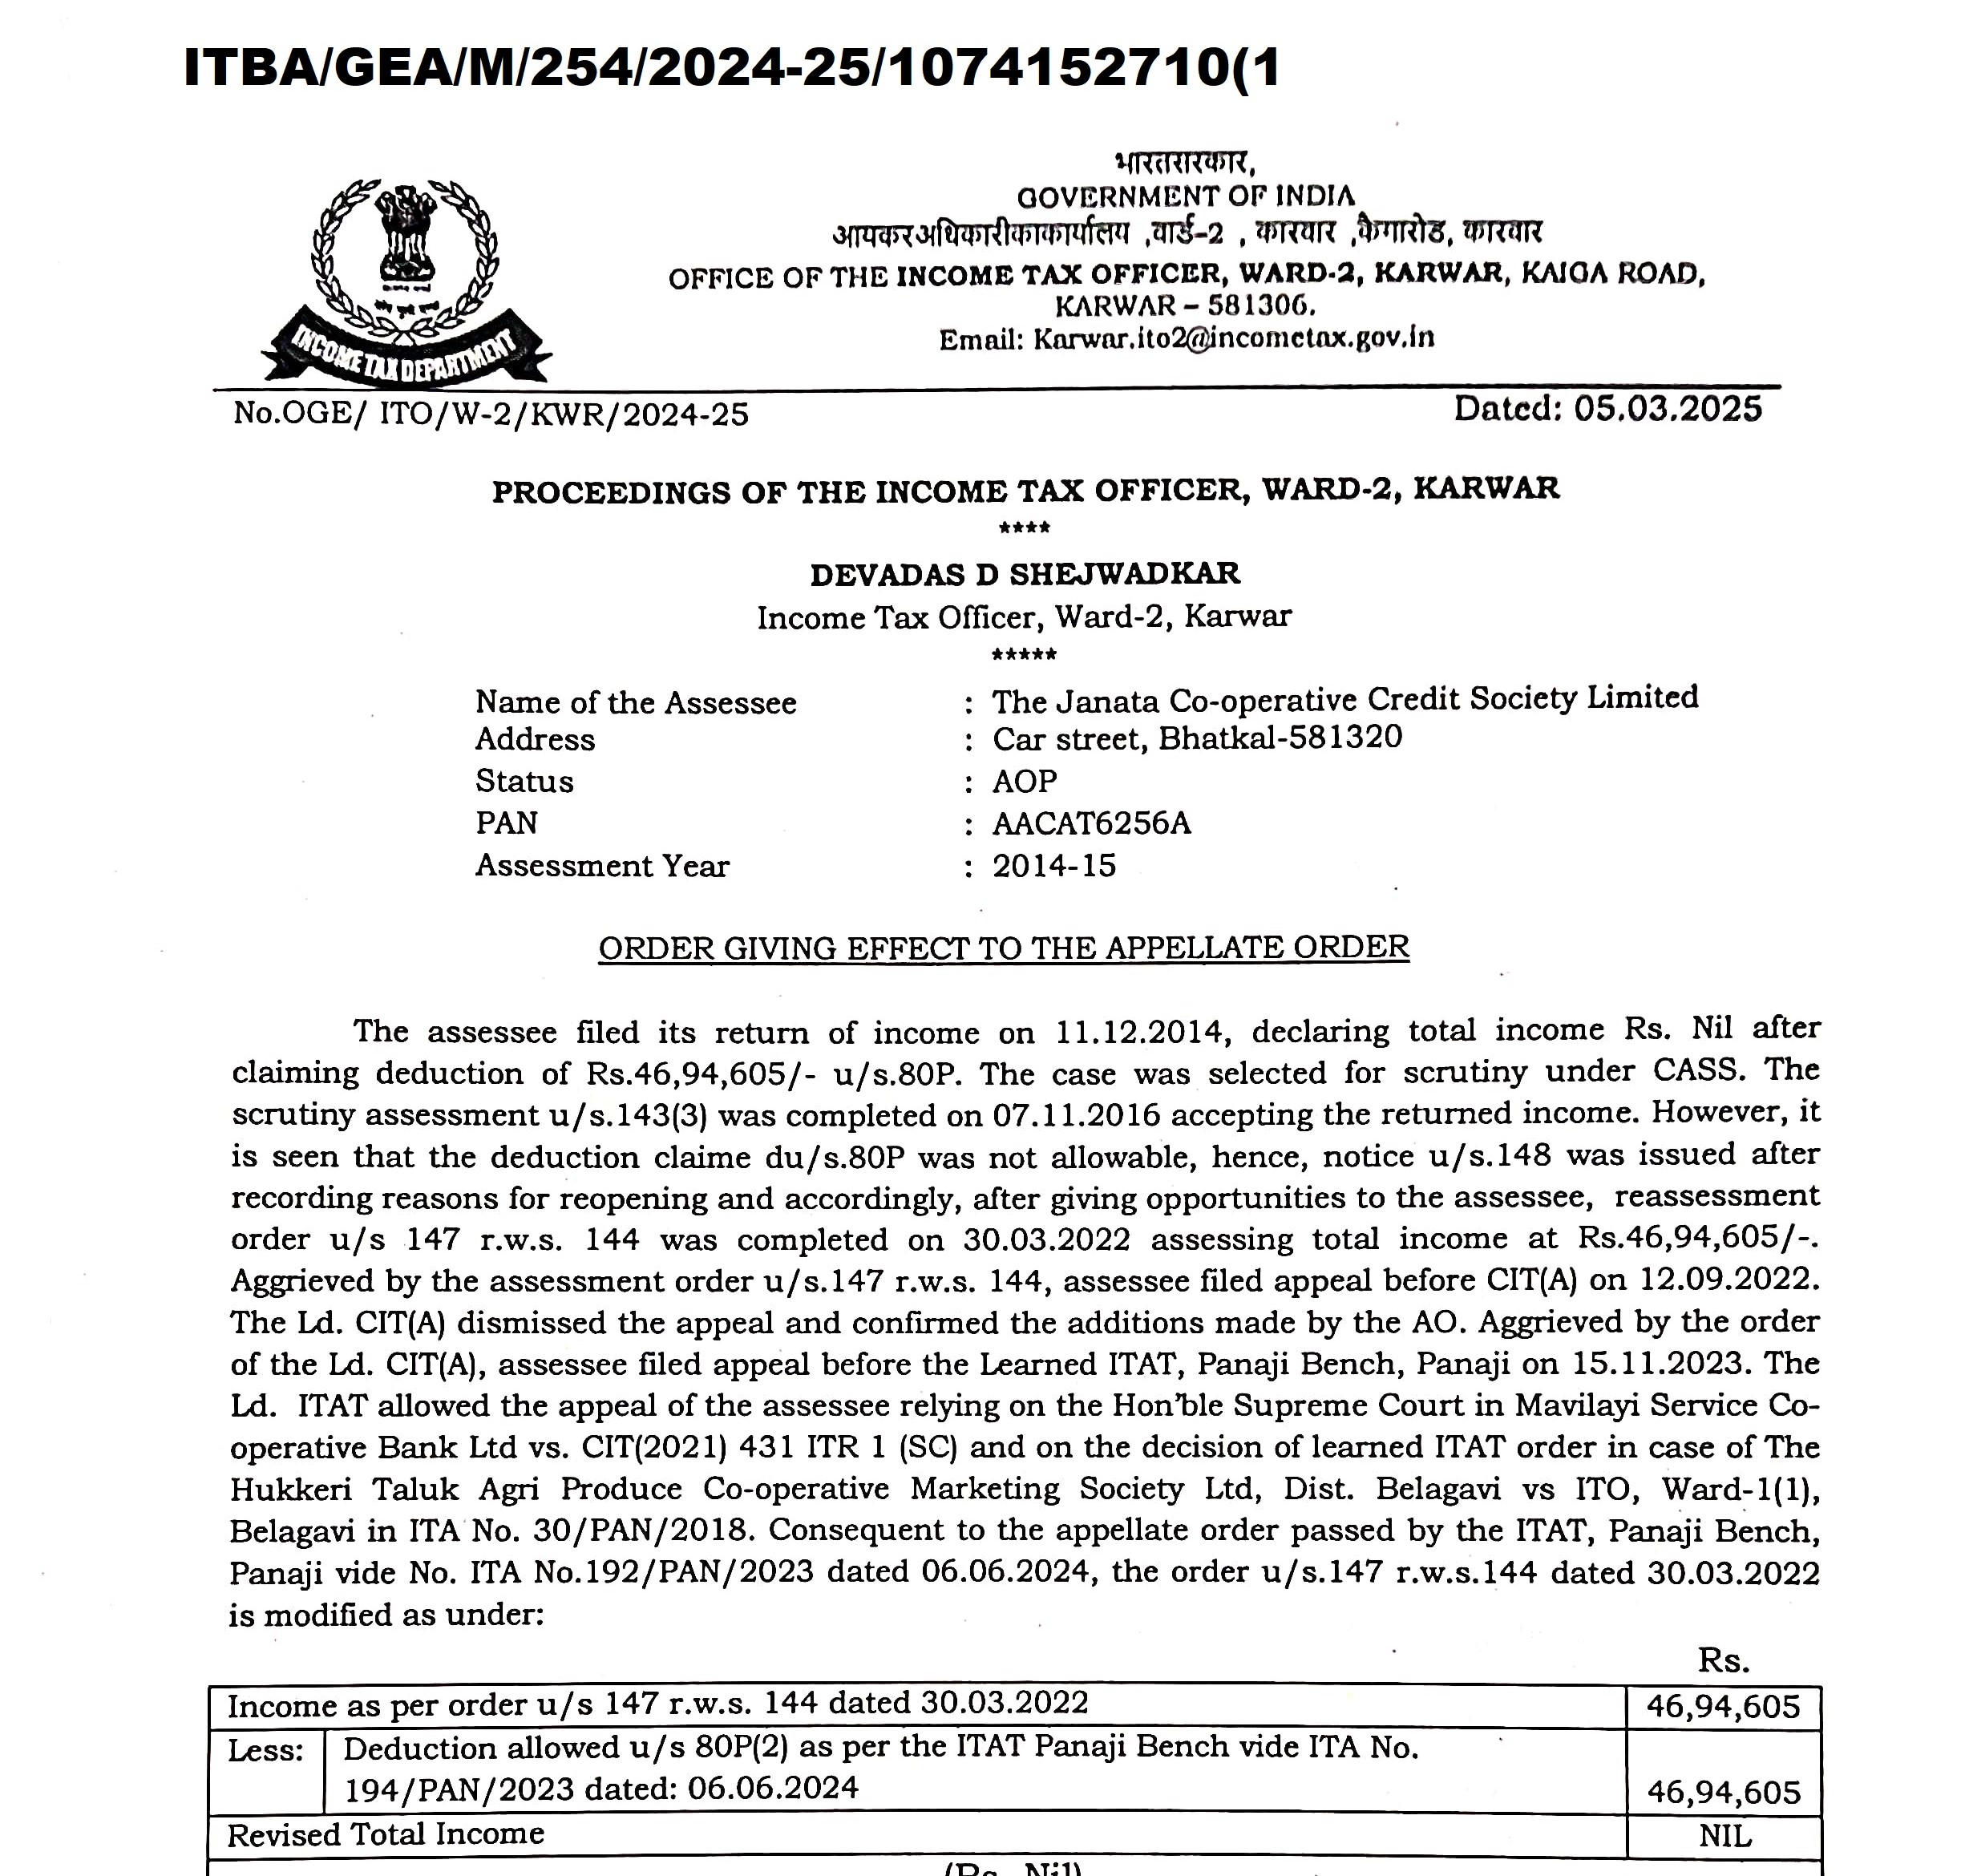
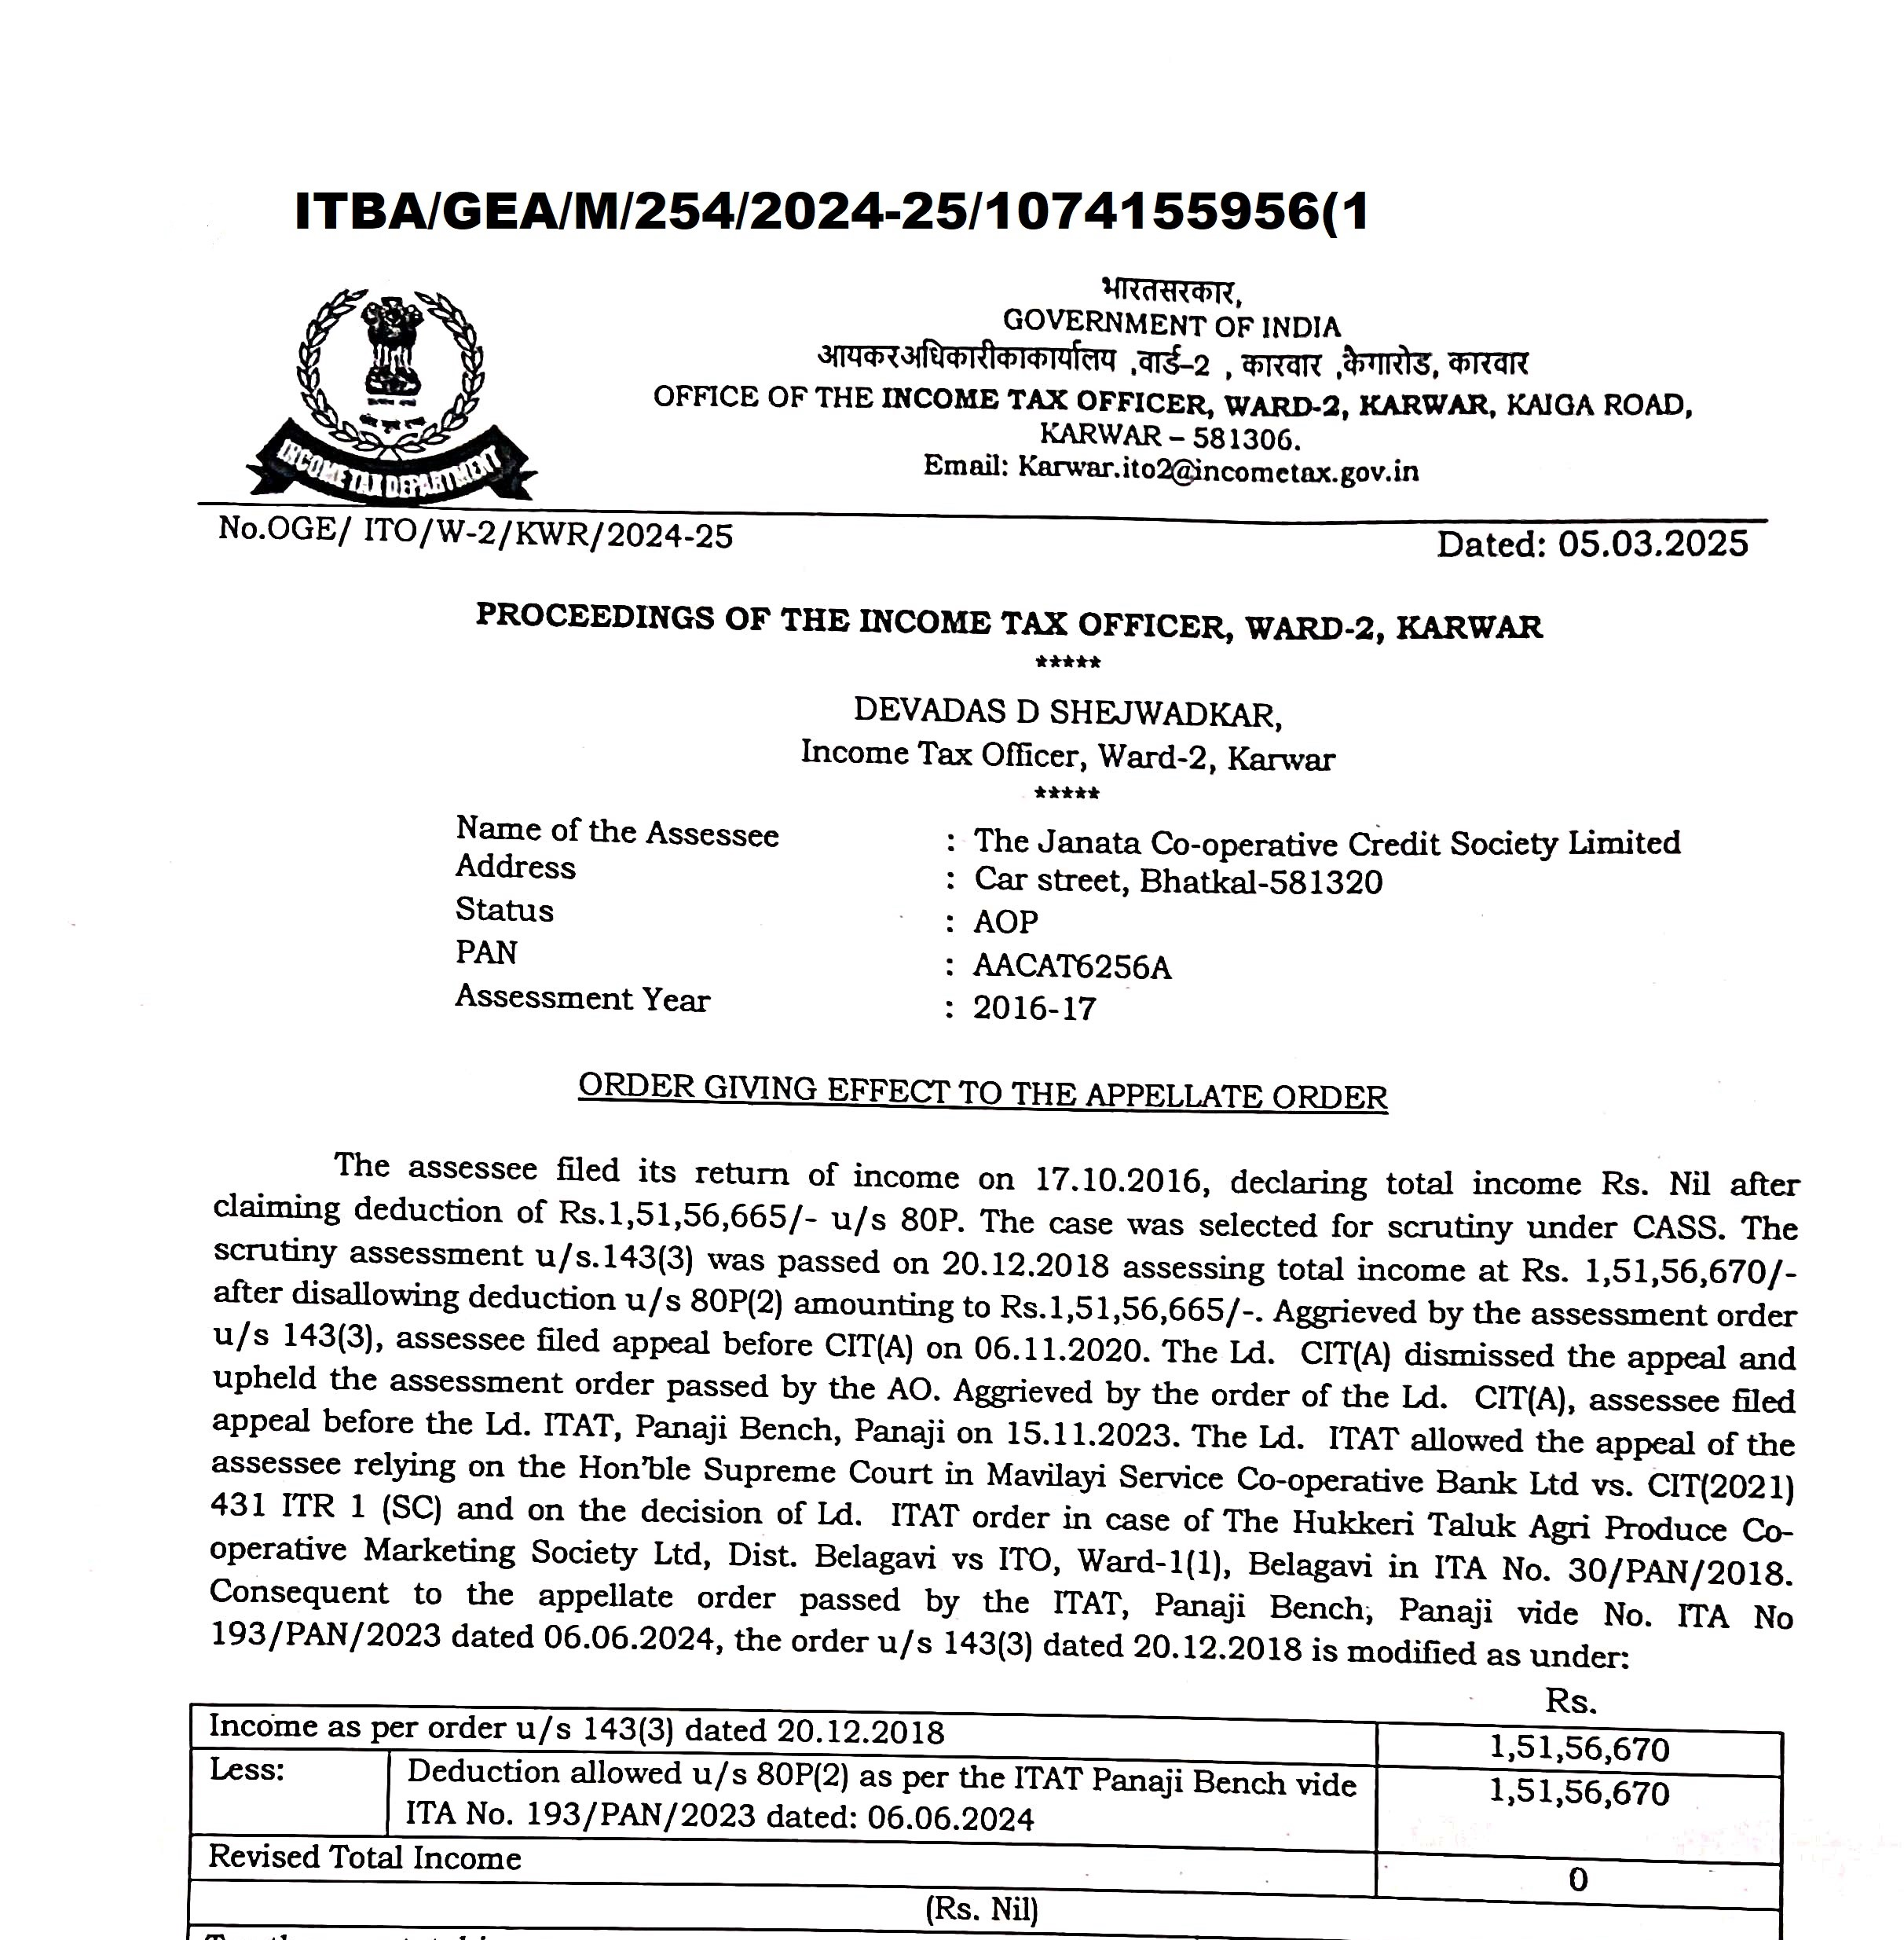
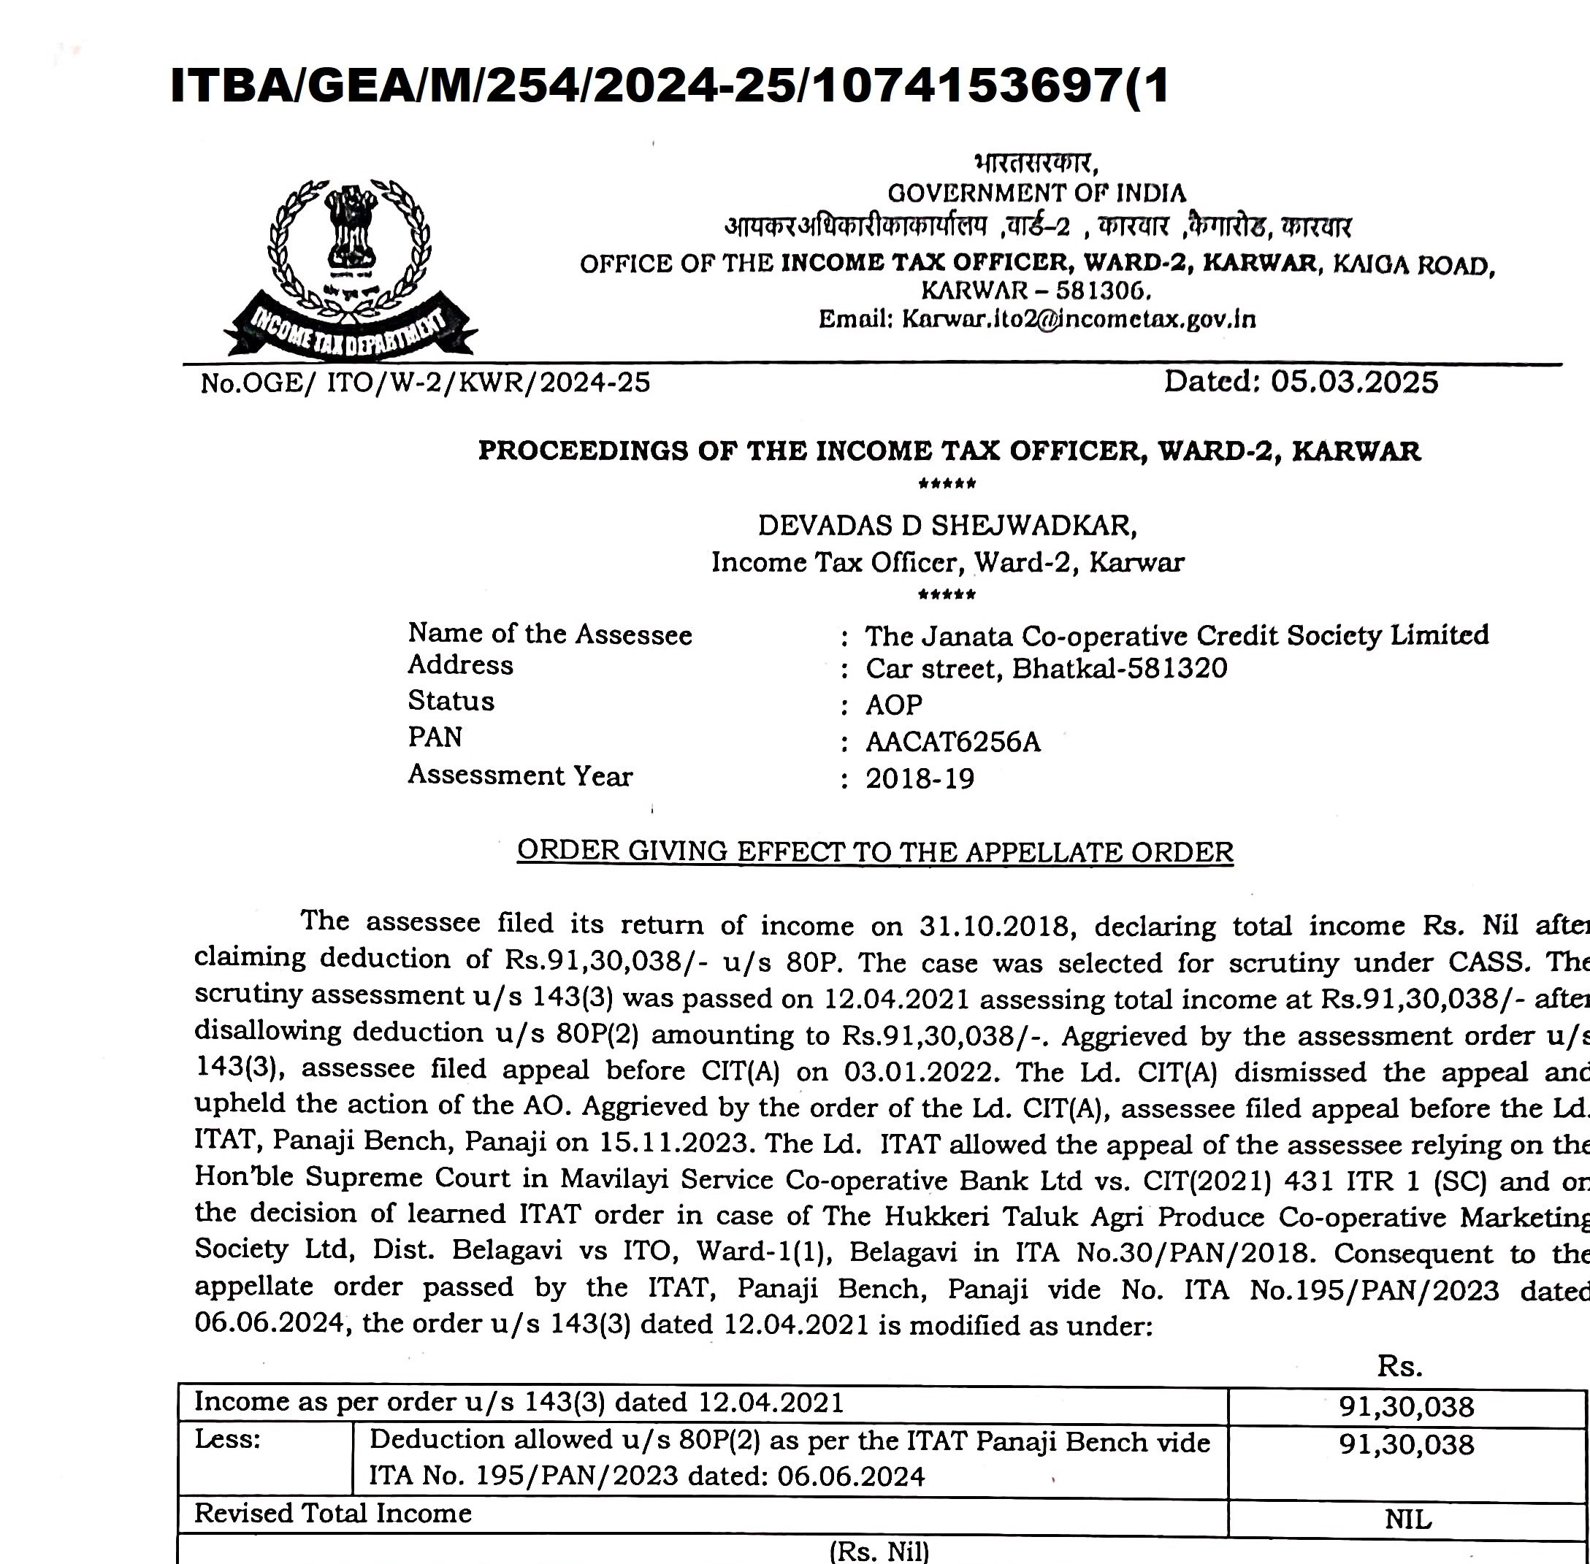
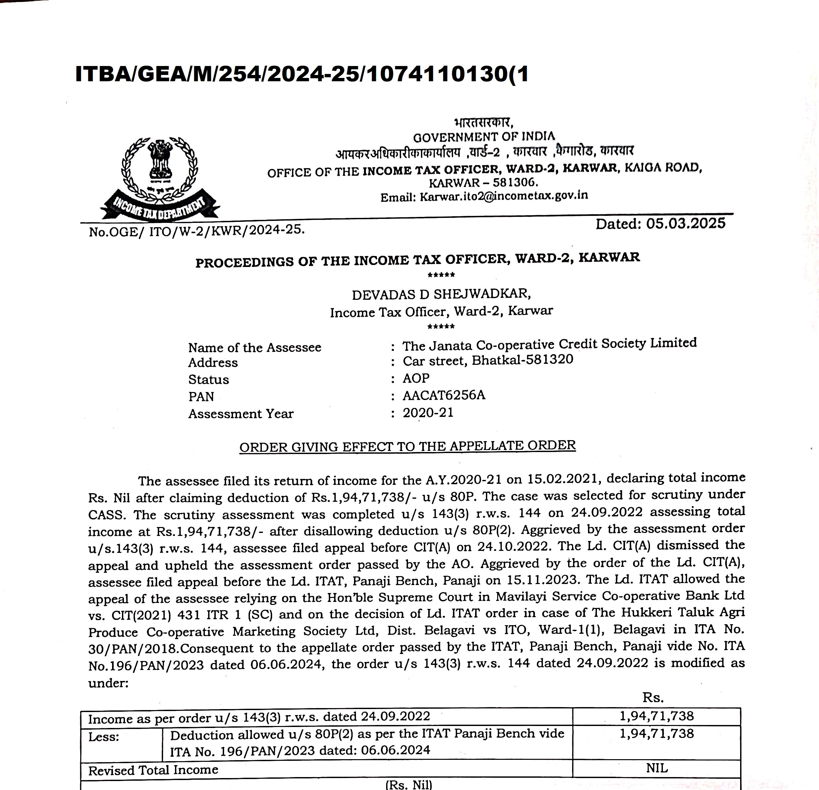

Slide 6
I COMPLIANCES
Section 139 of the income Tax Act
Section 80AC of the Income Tax Act
Section 119(2)(b) of the Income Tax Act
TDS and TCS
Section 80P of the Income Tax Act
Section 115 BAD of the Income Tax Act

Slide 7
II Major challenges
Principal of Mutuality
Interest from Nationalized Bank
Interest from co operative bank
Not a Co operative
Un explained money, un explained investments

Slide 8
III major challenges
Income from Other Source
Cost of Fund
Section 148 of the Income Tax Act Income escaping Assessment
Two PAN
Sec 144 of the Income tax Act
263 Proceedings
Points to be considered in Tax Audits
7411084358 cavarunbhat@gmail.com

Slide 9
I(A) Section 139 of the income Tax Act
(1)Every person,—
(a)being a company or a firm; or
(b)being a person other than a company or a firm, if his total income or the total income of any other person in respect of which he is assessable under this Act during the previous year exceeded the maximum amount which is not chargeable to income-tax,
7411084358 cavarunbhat@gmail.com

Slide 10
I(A) Section 139 of the income Tax Act
Provided also that every person, being an individual or a Hindu undivided family or an association of persons or a body of individuals, whether incorporated or not, or an artificial juridical person, if his total income or the total income of any other person in respect of which he is assessable under this Act during the previous year, without giving effect to the provisions of clause (38) of section 10 or section 10A or section 10B or section 10BA or section 54 or section 54B or section 54D or section 54EC or section 54F or section 54G or section 54GA or section 54GB or Chapter VI-A exceeded the maximum amount which is not chargeable to income-tax, shall, on or before the due date, furnish a return of his income or the income of such other person during the previous year, in the prescribed form and verified in the prescribed manner and setting forth such other particulars as may be prescribed:

Slide 11
I(B) Section 80AC of the income Tax Act
Deduction not to be allowed unless return furnished.
80AC. Where in computing the total income of an assessee of any previous year relevant to the assessment year commencing on or after—
(ii) the 1st day of April, 2018, any deduction is admissible under any provision of this Chapter under the heading "C.—Deductions in respect of certain incomes",
no such deduction shall be allowed to him unless he furnishes a return of his income for such assessment year on or before the due date specified under sub-section (1) of section 139.
7411084358 cavarunbhat@gmail.com

Slide 12
I(B) Section 80AC of the income Tax Act
(a) where the assessee other than an assessee referred to in clause (aa) is—
(ii) a person (other than a company) whose accounts are required to be audited under this Act or under any other law for the time being in force;
the 31st day of October of the assessment year;
7411084358 cavarunbhat@gmail.com

Slide 13
I(C) Section 119 (2)(b)of the income Tax Act
Circular No.13 /2023 dated 26-07-2023
In order to mitigate genuine hardship in cases referred to in para 3, the Board, in exercise or the powers conferred under section 119 of the Act, hereby directs that the Chief Commissioners of Income· tax (CCIT) / Directors General of lncome·tax (DGIT) are authorised to deal with such applications of condonation of delay pending before the Board, upon transfer of such applications by the Board, and decide such applications on merits, in accordance with the law.

Slide 14
I(C) Section 119 (2)(b)of the income Tax Act
Circular No.13 /2023 dated 26-07-2023
The Board hereby further directs that the CCIT/DGIT, henceforth, shall admit all pending as well as new applications for condonation of delay in furnishing returns of income claiming deduction u/s 80P of the Act, filed either in the Board or in field formation for the assessment years 2018·19 to 2022·23 and decide such applications on merits in accordance with the law where such person is required to get his accounts audited under respective State Laws.

Slide 15
I(C) Section 119 (2)(b)of the income Tax Act
Circular No.13 /2023 dated 26-07-2023
In the context of para·5 above, the CClT/DGIT while deciding such applications for condonation of delay in furnishing return of income, shall satisfy themselves that the applicant’s case is a fit case for condonation under the existing provisions of the Act. The CClT/DGIT shall examine the following while deciding such applications
7411084358 cavarunbhat@gmail.com

Slide 16
I(C) Section 119 (2)(b)of the income Tax Act
Circular No.13 /2023 dated 26-07-2023
the delay in furnishing the return of income within the due date under sub·section (I) of section 139 of the Act was caused due to circumstances beyond the control of the assessee with appropriate documentary evidence/s;
Where delay in furnishing return of income was caused due to delay in getting the accounts audited by statutory auditors appointed under the respective State Law under which such person is required to get his accounts audited, the date of completion of audit vis·a·vis the due date of furnishing the return of income under sub·section (I) of section 139 of the Act; and

Slide 17
I(C) Section 119 (2)(b)of the income Tax Act
Circular No.13 /2023 dated 26-07-2023
any other issue indicating towards tax avoidance or tax evasion specific to the case, which comes into the light in the course of verification and having bearing either in the relevant assessment year or establishing connection of relevant assessment year with other assessment year/s
The cases falling under para 6(iii) above, would require further necessary action as per law
7411084358 cavarunbhat@gmail.com

Slide 18
I(C) Section 119 (2)(b)of the income Tax Act
Circular No.13 /2023 dated 26-07-2023
The CClT/DGlT shall preferably dispose the application within three months from the end of the month in which such application is received from the applicant or transferred by the Board. No order rejecting the application under section 119(2)(b) of the Act shall be passed without providing the applicant an opportunity of being heard.
7411084358 cavarunbhat@gmail.com

Slide 19
I(D) Applicability of TDS and Tcs
Turnover Limit of 50L or 1Cr applicable only to the Individual and HUF and not for Others
Disallowance of expenditure: 40(a)(i)(a)
Levy of Interest: U/S 201(1A)
Levy of Penalty U/S 271C
7411084358 cavarunbhat@gmail.com

Slide 20
I(d) Section 80P of the income Tax Act
80P. (1) Where, in the case of an assessee being a co-operative society, the gross total income includes any income referred to in sub-section (2), there shall be deducted, in accordance with and subject to the provisions of this section, the sums specified in sub-section (2), in computing the total income of the assessee.
7411084358 cavarunbhat@gmail.com

Slide 21
I(d) Section 80P(2)(a)(i) of the income Tax Act
in the case of a co-operative society engaged in—
(i) carrying on the business of banking or providing credit facilities to its members, or
(ii) a cottage industry, or
(iii) the marketing of agricultural produce grown by its members, or
7411084358 cavarunbhat@gmail.com

Slide 22
I(d) Section 80P(2)(a)(i) of the income Tax Act
(iv) the purchase of agricultural implements, seeds, livestock or other articles intended for agriculture for the purpose of supplying them to its members, or
(v) the processing, without the aid of power, of the agricultural produce of its members, or
(vi) the collective disposal of the labour of its members, or
7411084358 cavarunbhat@gmail.com

Slide 23
I(d) Section 80P(2)(a)(i) of the income Tax Act
(iv) Fishing or allied activities, that is to say, the catching, curing, processing, preserving, storing or marketing of fish or the purchase of materials and equipment in connection there with for the purpose of supplying them to its members,
the whole of the amount of profits and gains of business attributable to any one or more of such activities :
7411084358 cavarunbhat@gmail.com

Slide 24
I(d) Section 80P(2)(B) of the income Tax Act
in the case of a co-operative society, being a primary society engaged in supplying milk, oilseeds, fruits or vegetables raised or grown by its members to—
(i) a federal co-operative society, being a society engaged in the business of supplying milk, oilseeds, fruits, or vegetables, as the case may be; or
7411084358 cavarunbhat@gmail.com

Slide 25
I(d) Section 80P(2)(B) of the income Tax Act
(ii) the Government or a local authority; or
(iii) a Government company as defined in section 617 of the Companies Act, 1956 (1 of 1956), or a corporation established by or under a Central, State or Provincial Act (being a company or corporation engaged in supplying milk, oilseeds, fruits or vegetables, as the case may be, to the public),
the whole of the amount of profits and gains of such business;
7411084358 cavarunbhat@gmail.com

Slide 26
I(d) Section 80P(2)(B) of the income Tax Act
In the case of a co-operative society engaged in activities other than those specified in clause (a) or clause (b) (either independently of, or in addition to, all or any of the activities so specified), so much of its profits and gains attributable to such activities as does not exceed,—
(i)where such co-operative society is a consumers' co-operative society, one hundred thousand rupees; and
(ii)in any other case, fifty thousand rupees.
7411084358 cavarunbhat@gmail.com

Slide 27
I(d) Section 80P(D) of the income Tax Act
In respect of any income by way of interest or dividends derived by the co-operative society from its investments with any other co-operative society, the whole of such income;
7411084358 cavarunbhat@gmail.com

Slide 28
I(d) Section 80P(e) of the income Tax Act
In respect of any income derived by the co-operative society from the letting of godowns or warehouses for storage, processing or facilitating the marketing of commodities, the whole of such income;
7411084358 cavarunbhat@gmail.com

Slide 29
I(E) Section 115 BAD of the Income Tax Act
Tax rate -22%
Return to be furnished u/s 139(1)
Without any deduction
without set off of any loss carried forward or depreciation from any earlier assessment year, if such loss or depreciation is attributable to any of the deductions
once the option has been exercised for any previous year, it cannot be subsequently withdrawn for the same or any other previous year
7411084358 cavarunbhat@gmail.com

Slide 30
II(A) principal of mutuality
Regular Member, Associate member and Nominal members
Citizen Co operative Society
Honorable Panaji ITAT in The Karnataka Karavali Urban Coop Credit Society Ltd., - ITA Nos.457 & 458/PAN/2018
Cochin ITAT in Nilambur Service Co-op Bank Ltd. - 01 Feb 2018 & Cochin ITAT in The Muttom Service Co-op Bank Ltd. - 15 Jan 2018
Madras HC - Ammapet Primary Agri. Co-op. Bank - 06 Dec 2018
Ahmedabad ITAT in Trapaj Vibhageeya Khet Udyog
7411084358 cavarunbhat@gmail.com

Slide 31
II(B) Interest from nationalized bank
7411084358 cavarunbhat@gmail.com

Slide 32
II(C) Interest from Co operative bank
7411084358 cavarunbhat@gmail.com

Slide 33
II(D) Not a Co- operative
UDAYA SOUHARDA CREDIT CO-OPERATIVE SOCIETY LTD
M/S Swabhimani Souharda Credit Co ... vs Government Of India
WRIT PETITION NO. 48414 OF 2018 (T-IT) C/W WRIT PETITION NO. 14381 OF 2019 (T-IT) IN W.P. NO. 48414/2018:
7411084358 cavarunbhat@gmail.com

Slide 34
II(E) Un explained money, un explained investments
Section 68, Section 69 of the Income Tax Act
Cash deposit during demonetization
Cash deposits and withdrawals
7411084358 cavarunbhat@gmail.com

Slide 35
III(A) Income from Other Source
Interest earned from the investment outside the business
Taxable U/s 56 of the Income Tax Act.
Totagars Sale Society (High Court Judgement)
Allowable expenditure u/s 57 of the Income tax Act
7411084358 cavarunbhat@gmail.com

Slide 36
III(B) COST OF Fund
For claiming expenditure u/s 57 of the Income Tax Act
Specific format for cost of fund
7411084358 cavarunbhat@gmail.com

Slide 37
III(C) income escaping assessment
Sec 149(A) of the Income Tax Act
Sec 148 of the income Tax Act
7411084358 cavarunbhat@gmail.com

Slide 38
III(C) Sec 144 of the Income Tax Act
Best judgement assessment based on the records available with the AO
Cash deposit, Cash withdrawals
Taxed under 115BBE of the income tax act
7411084358 cavarunbhat@gmail.com

Slide 39
III(D) TWO PAN
Two PAN for the same co operative society
Filing the return of income in one PAN
For the purpose of KYC, society has provided the different PAN
7411084358 cavarunbhat@gmail.com

Slide 40
III(E) Sec 144 of the Income Tax Act
Best judgement assessment based on the records available with the AO
Cash deposit, Cash withdrawals
Taxed under 115BBE of the income tax act
7411084358 cavarunbhat@gmail.com

Slide 41
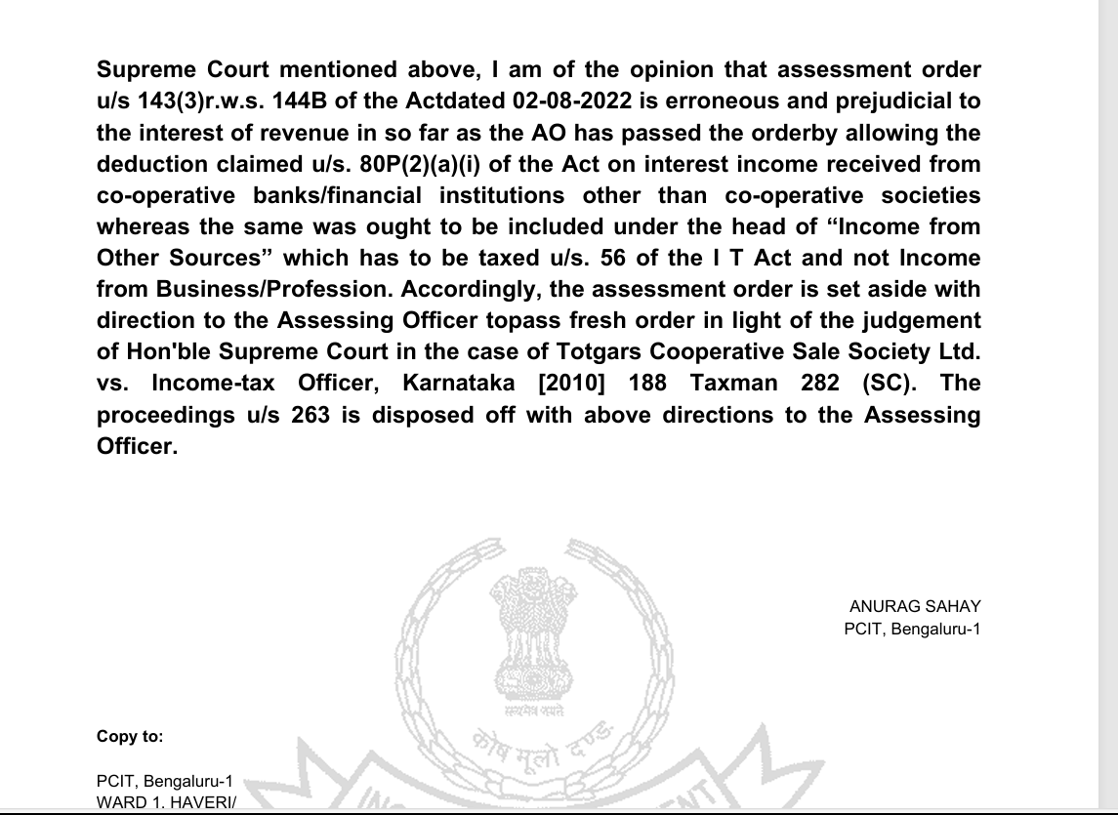
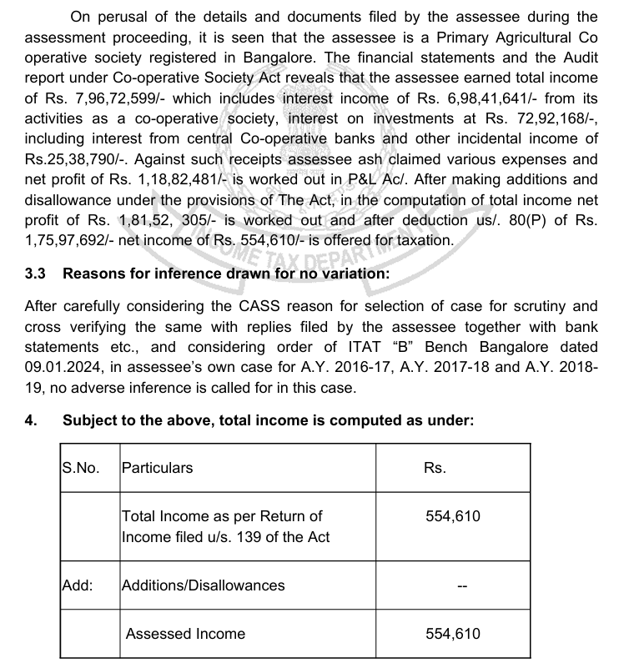
III(F) 263 proceedings
7411084358 cavarunbhat@gmail.com

Slide 42
III(G) issues in Tax audit
Interest on income tax payments
Interest on Income tax Refund
TDS on year end provision
Adjustment required to be made to the profits or loss for complying with the income computation and disclosure standards (ICDS)
7411084358 cavarunbhat@gmail.com

Slide 43
III(G) issues in Tax audit
Particulars of payments made to persons specified under section40A (2)(b)
Weather we need to disclose only the expenditure debited to profit and loss accounts or all the payments
As the clause requires an auditor to report all the payments made to the specified persons, the payments made for capital purchases should also be considered for reporting under this clause.
7411084358 cavarunbhat@gmail.com

Slide 44
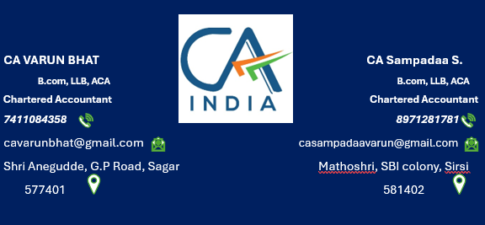
7411084358 cavarunbhat@gmail.com

