Slide 1
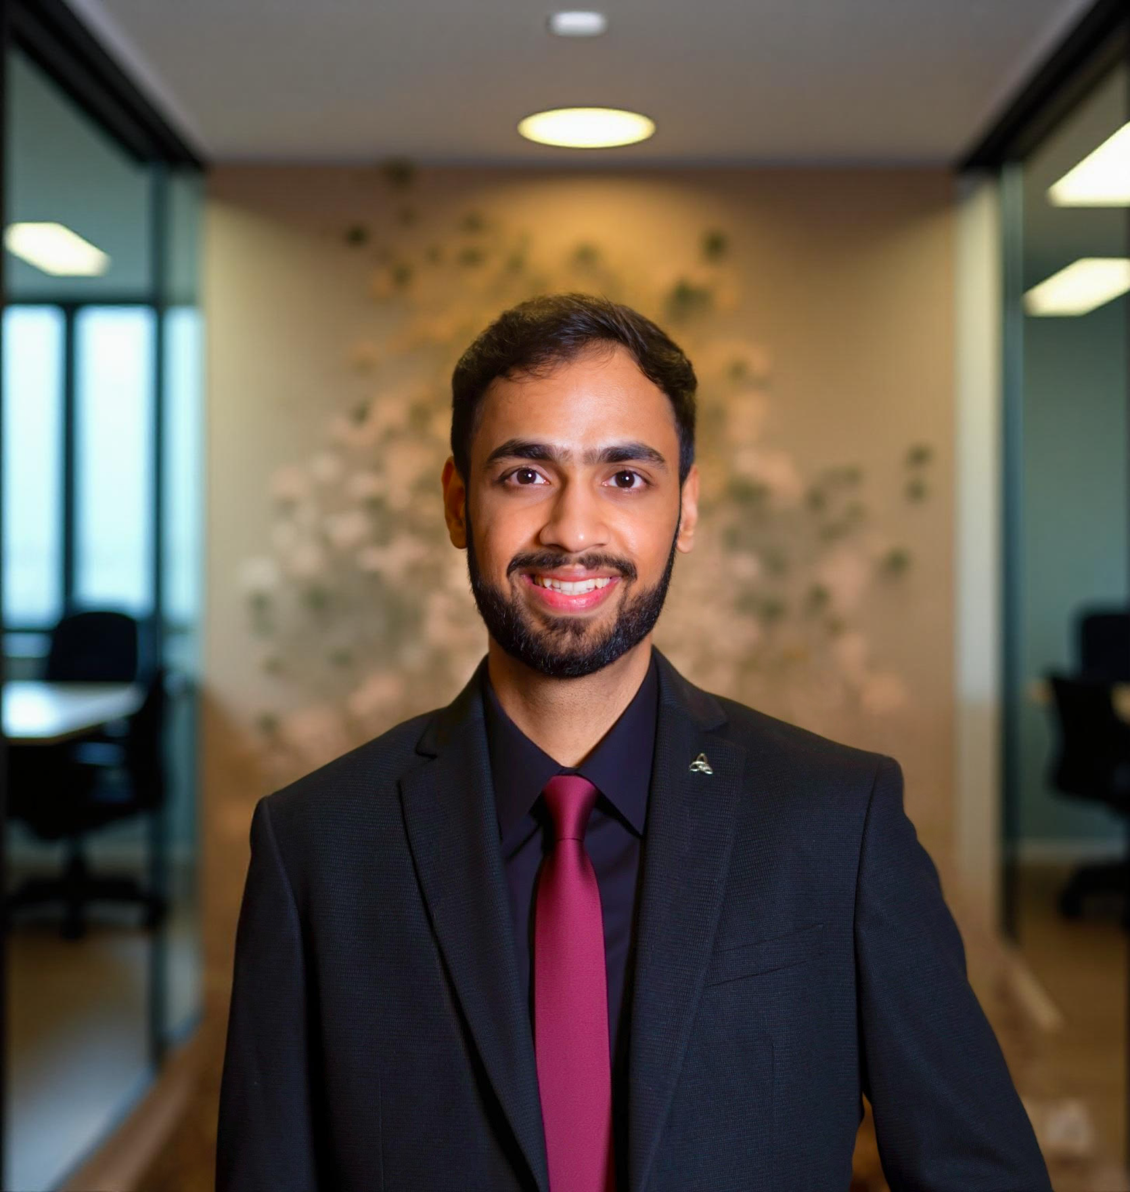
Udupi 2025, ICAI
Friday, 27th June, 2025
Navigating the tax & funding incentives and building Financial Discipline in Startups – CA’s role as Trusted Advisors to Startups
Kartikeyan Khator, FCA

Slide 2
“
Startups are nothing but an idea that manifests into a commercial undertaking

Slide 3
New age business (new or substantially improved)
Uses technology
Relies heavily on external investments
Raises multiple rounds of investments
Varying valuations
Issues creative instruments to raise capital
Can grow 100x in 4-5 years
Automation across all processes
Cross border transactions
Startup Peculiarities

Slide 4
Strength in Numbers
3rd
Largest ecosystem in the World
30K+
Startups in Karnataka since 2010
1.79 Lakh+
DPIIT Registered Startups
160
Startups in Udupi since 2010
3950+
80-IAC registered startups
₹55,000 Cr.+
Equity Funding in 2025 alone

Slide 5

What do we understand by a Registered Startup?

Slide 6
Defining Startups
Particulars | DPIIT | Income Tax |  | Companies Act
 |  | 56(2)(viib) | 80 IAC
Nature of Activity | Innovation, Development or Improvement Scalable Business Model with a high potential of employment generation or wealth creation | Same as DPIIT | Innovation, Development, Deployment, Commercialization of new products, processes or services driven by technology or intellectual property | Same as DPIIT
Age | 10 years | 10 years | Formed after 1.4.16 | Same as DPIIT
Paid up Capital | Not mentioned | INR 25Cr | Not mentioned | Same as DPIIT
Turnover | INR 100 crore | Same as DPIIT | Same as DPIIT | Same as DPIIT
Legal Structure | Private Ltd. Company, LLP, Registered Partnership | Private Company | Private Ltd. Company, LLP | Private Company
Specific Declaration | No | Form 2 | Form 1 | No
Reserve Bank: Same as DPIIT
Notes: No splitting up or reconstruction or transferring machinery from existing businesses allowed. Moreover, it will cease to be a Startup once it crosses the threshold limit.

Slide 7
Tax Incentives
Funding Incentives
DPIIT Recognition
Financial Discipline
Areas of Practice
IMB Registration
Kartikeyan Khator, FCA
Notes:
Conversion to another permissible form

Slide 8
Tax Incentives
DPIIT Recognition
Funding Incentives
Financial Discipline
Angel Tax Exemption u/s 56(2)(viib)
Companies Act:
  ESOPs relief
  Minimum number of board meetings reduced
  CFS can be avoided in FS
  DVR increased from 26% to 76%
Other – Patent filing, self-declaration for labour law compliance, ease of requirements on GeM
Areas of Practice
Kartikeyan Khator, FCA
Notes:
Conversion to another permissible form

Slide 9
Tax Incentives
IMB Registration
Funding Incentives
Financial Discipline
Tax Holiday u/s 80-IAC
ESOP relief u/s 17(2)(vi)
Carry forward of losses u/s 79
Areas of Practice
Kartikeyan Khator, FCA
Notes:
Conversion to another permissible form

Slide 10
Tax Incentives
Funding Incentives
Financial Discipline
Who can be registered under DPIIT?
Areas of Practice
Who can be registered with IMB for 80-IAC benefit?
Kartikeyan Khator, FCA
Notes:
Conversion to another permissible form

Slide 11
Tax Incentives
Funding Incentives
Who can be registered under DPIIT?
Financial Discipline
Who can be registered with IMB for 80-IAC benefit?
Areas of Practice
What are the roles of a CA?
Kartikeyan Khator, FCA
Notes:
Conversion to another permissible form

Slide 12
Tax Incentives
Funding Incentives
Who can be registered with IMB for 80-IAC benefit?
Financial Discipline
What are the roles of a CA?
Areas of Practice
Kartikeyan Khator, FCA
Notes:
Conversion to another permissible form

Slide 13
Tax Incentives
SIDBI Fund of Funds
Funding Incentives
SISF Scheme
Financial Discipline
Areas of Practice
CGSS
Sectoral Schemes – BIRAC, iDEX, TDF, etc.
Kartikeyan Khator, FCA
Notes:
Conversion to another permissible form

Slide 14
Tax Incentives
SIDBI Fund of Funds
Funding Incentives
SISF Scheme
Financial Discipline
Areas of Practice
CGSS
Sectoral Schemes – BIRAC, iDEX, TDF, etc.
Kartikeyan Khator, FCA
Notes:
Conversion to another permissible form

Slide 15
Tax Incentives
When to raise?
Funding Incentives
How much to raise?
Financial Discipline
Areas of Practice
How to prepare for fundraise?
How to maintain Investor Confidence?
Kartikeyan Khator, FCA
Notes:
Conversion to another permissible form

Slide 16
Tax Incentives
When to raise?
Funding Incentives
Should you raise in pre-revenue stage?
Disruptive Innovation vs Sustaining Innovation
Should you raise only to repay loans?
Should you raise only because competitors are raising?
Should you raise to go slow?
Financial Discipline
Areas of Practice
Kartikeyan Khator, FCA
Notes:
Conversion to another permissible form

Slide 17
Tax Incentives
How much to raise?
Funding Incentives
Should you raise all at once?
What is the industry average?
Should you go higher than industry average?
Should you over dilute?
Financial Discipline
Areas of Practice
(INR Crores)
Kartikeyan Khator, FCA
Notes:
Conversion to another permissible form

Slide 18
Tax Incentives
How to raise?
Funding Incentives
Teaser Deck, Introductory Email, Pitch Deck
Financial Model for 3-5 years
Business Valuation
ESOPs
Data Room
Financial Discipline
Areas of Practice
Kartikeyan Khator, FCA
Notes:
Conversion to another permissible form

Slide 19
Tax Incentives
How to maintain Investor Confidence?
Funding Incentives
Unfunded & Funded Startups
Cost of non-compliance is higher than cost of compliance
Funded Startups
Process Standardization and Corporate Governance
Financial Discipline
Areas of Practice
Kartikeyan Khator, FCA
Notes:
Conversion to another permissible form

Slide 20
1
Incorporation
Private Company, LLP
First Auditors
Tax Incentives
2
Fundraise Preparation
Pitch Deck/IM, including market sizing and competitor landscaping
Detailed Financial Model/Business Projections
Business Valuation under 2-3 different methods
Data room preparation
When to raise, how much to raise
Internal due diligence
Deal structuring – instrument, terms, dilution
Funding Incentives
Financial Discipline
For Startups
Fundraise
Connecting with the right set of investors
Leading discussions
Deal documentation
Deal negotiation and closure
Areas of Practice
3
4
Post Fundraise
Secretarial filings in relation to the deal
MIS reports for investor relations
Standard Operating Procedures (SOP) development
Shared CFO – outsourcing entire finance function, including accounts, compliances, strategic finance
Audit and Assurance
On demand compliance support – GST, IT, RoC, FEMA, etc.
Kartikeyan Khator, FCA
Notes:
Conversion to another permissible form

Slide 21
1
Deal Scouting and Market Research
Pin pointing areas of focus
Educating the investors about certain Sectors
Finding the best investment opportunities based on thesis
Tax Incentives
2
Due Diligence
Finance Due Diligence
Legal Due Diligence
Market Due Diligence
Funding Incentives
Financial Discipline
For Investors
Business Valuation
Validating the valuation of startups and conducting independent valuation to advise on the ideal range to negotiate
3
Areas of Practice
4
Other
Deal structuring documentation – SHA and Term Sheet
Fundraise for associated startups
Fundability assessment at the time of onboarding new ventures
Masterclass on finance domain – financial modelling, fundraise, startup schemes and strategic finance
Kartikeyan Khator, FCA
Notes:
Conversion to another permissible form

Slide 22
What does it take to serve Startups and Investors?
New Age
Mindset
Adaptable
Agility
Tech Savvy
Collaboration
22

Slide 23

Q&A

Slide 24
Udupi 2025, ICAI
Friday, 27th June, 2025
Thank You
M: +91 9830547380
E: kk@chunderkhator.in
L: Indiranagar, Bengaluru
Kartikeyan Khator, FCA

