Slide 1

Udupi Branch of SIRC of ICAI
Statutory Bank Branch Audit
Practical Aspects
CA Niranjan Joshi
07.03.2025
Restriction on Disclosure and Use of Data
The data in this document contains trade secrets and confidential or proprietary information of my firm, the disclosure of which would provide a competitive advantage to others. As a result, this document shall not be disclosed, used or duplicated, in whole or in part, for any purpose. The data subject to this restriction are contained in the entire document.

Slide 2
Disclaimer
These are my personal views and can not be construed to be the views of the ICAI or my firm.
No representations or warranties are made by the RC/Branch/Study Circle of RC with regard to this presentation.
These views do not and shall not be considered as a professional advice.
This presentation should not be reproduced in part or in whole, in any manner or form, without our written permission.
CA Niranjan Joshi

Slide 3
Coverage
Audit Planning & Execution
Reporting
Certification
CA Niranjan Joshi

Slide 4

What to READ
Link for Standards on Auditing – AASB of ICAI
https://www.icai.org/new_post.html?post_id=450
Link for AASB of ICAI Publications
https://www.icai.org/post/icai-publications-auditing-assurance-standards-board
CA Niranjan Joshi

Slide 5
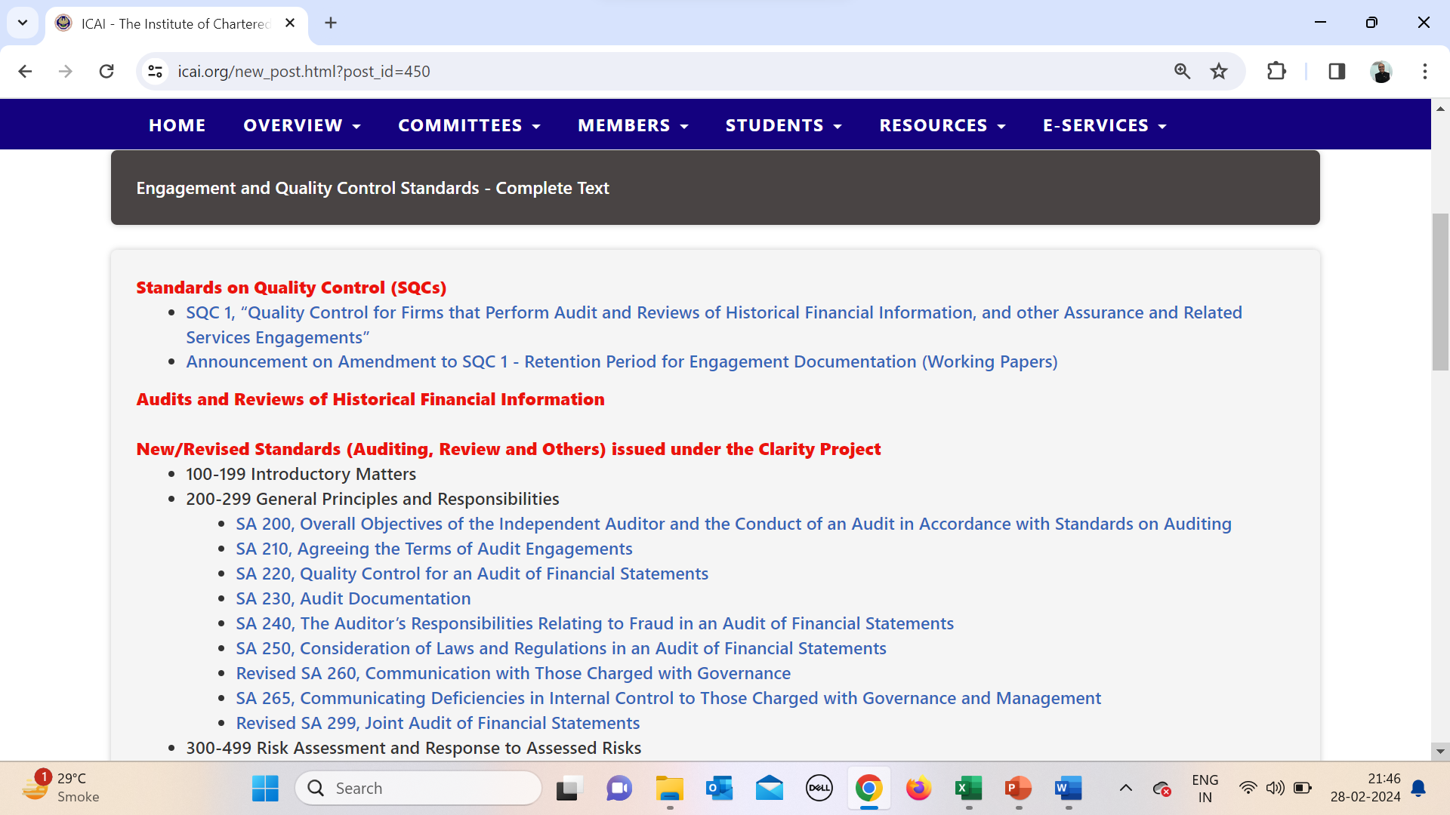
What to READ
CA Niranjan Joshi

Slide 6
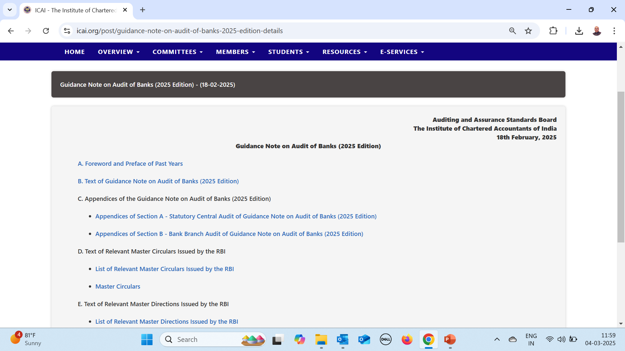
What to READ
CA Niranjan Joshi

Slide 7
COE Fundamental Principles – Independence
Integrity - Straightforward and honest approach, Fair dealing and truthfulness, Do not associate with communication or information containing false or misleading information, Steps to disassociate with above information once known
Objectivity - Not to compromise professional or business judgment because of bias, conflict of interest or undue influence of others. Not to undertake a professional activity if it unduly influences the accountant’s professional judgment.
Professional Competence and Due Care - Attain and maintain professional knowledge and skill, Act diligently and in accordance with applicable technical and professional standards, Ensure appropriate training and supervision of subordinates
CA Niranjan Joshi

Slide 8
COE Fundamental Principles – Independence
Confidentiality - Maintain confidentiality of information acquired as a result of professional and employment relationships, Disclose information when required by law or authorised by the client, Consider relevant factors while deciding disclosure of confidential information, Maintain confidentiality even after the end of relationship with client
Professional Behaviour - Avoid activities that impair the reputation of the profession, Do not make exaggerated claims for services offered, and disparaging references or unsubstantiated comparisons with others, Do not advertise any professional/other facts which are in violation of Advertisement Guidelines of ICAI
Threats to Avoid
Self Interest Threat, Self Review Threat, Advocacy Threat,
Familiarity Threat, Intimidation Threat.
CA Niranjan Joshi

Slide 9



Audit Process
Audit Program
Audit Execution
Effective Reporting
Working Papers
CA Niranjan Joshi

Slide 10
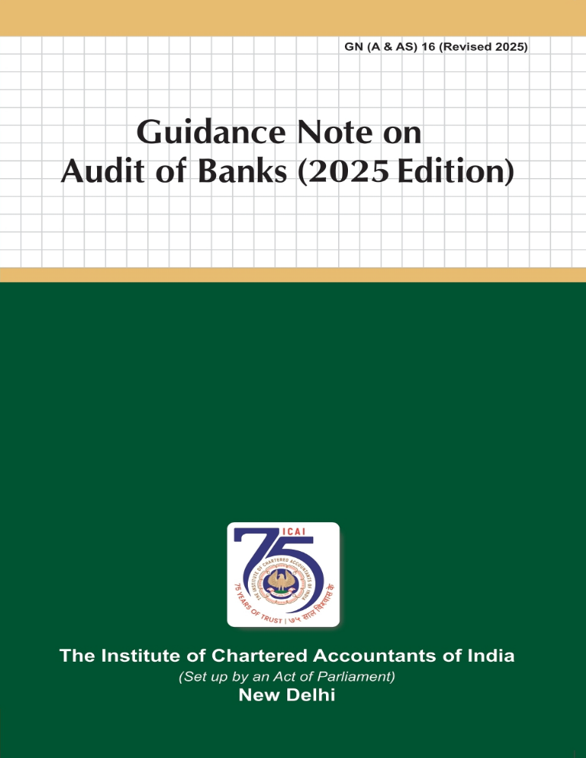
Guidance Note on Audit of Banks 2025
10
CA Niranjan Joshi

Slide 11

Audit Trail
Manual Registers / Records
Core Banking Solution CBS
Management Information System
Data made available for remote audit
Lack of Adequate Information
Lack of Adequate Knowledge of system
Lack of audit Trail
CA Niranjan Joshi

Slide 12
Audit Planning & Checklist
Applicable Act for the Bank
Appointment Letter / Acceptance Letter
Closing Manual of Bank
NOC of Previous Auditor.
Audit Engagement Letter.
Basic Information from branch.
Audit Program / Checklist
Study RBI Circulars
Attend Trainings / Workshops / Seminars
Have knowledge of current affairs
12
CA Niranjan Joshi

Slide 13
Audit Program
  Define broadly the scope of audit.
  Include Certificates in main audit plan.
  Identify the thrust areas.
  Set materiality levels standards for each area.
  Lay down over all time schedule.
  Training to Audit staff and special skill if required.
  Weak areas identified during the Audit – extra focus.
  Physical verification of cash and other securities / Sensitive Accounts
  Frauds / Sundry Assets / Suspense Account / Inter Branch reconciliation
  Contingent Liabilities
  Contingent Liabilities not acknowledged
13
CA Niranjan Joshi

Slide 14
Coverage
Audit Planning & Execution
Reporting
Certification
CA Niranjan Joshi

Slide 15
Reporting
    Statutory Audit Report – Addressed to SCA/Bank
    SA 700 – Forming an opinion & Reporting on Financial Statements
    SA 701 – Communicating Key Audit Matters
    SA 705 – Modifications to the opinion in the independent auditors report
    SA 706 – Emphasis of Matter Paragraph or Other Matter Paragraph
    SA 720 – Auditors Responsibility relating to Other Information
    KAM / Modified Opinion / EOM / OM – all are different.
CA Niranjan Joshi

Slide 16
Reporting
    Compliance with Accounting Standards to be mentioned in main report.
    Qualifications can be through Memorandum of Changes or Specific remarks in the last para.
    Illustrative Format Bank Audit Guidance Note 2025
    Add annexures / supporting documents to the report wherever necessary
CA Niranjan Joshi

Slide 17
Memorandum of Changes – MOC
Memorandum of Changes (summary)
 | No. | Increase | Decrease
In respect of Income
In respect of expenditure
In respect of Assets
In respect of Liabilities
In respect of Gross NPAs
In respect of Provision on NPAs
In respect of Classification of Advances
In respect of Risk Weighted Assets
Other items (if any)
CA Niranjan Joshi

Slide 18
Long Form Audit Report
    Internal control evaluation questionnaire
    Comprehensive in scope and coverage
    Covers Balance Sheet & Profit & Loss A/c
    Important check list for Audit Plan
18
CA Niranjan Joshi

Slide 19
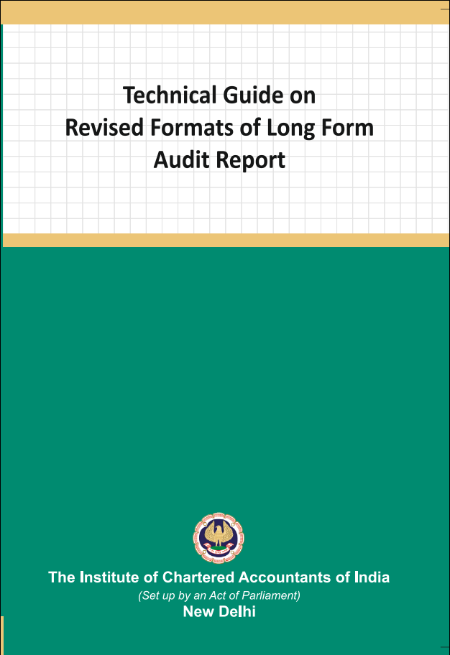
Technical Guide on Revised LFAR 2021
19
CA Niranjan Joshi

Slide 20
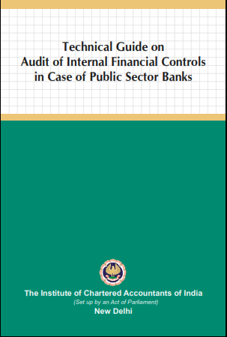
Technical Guide on IFCoFR 2021
20
CA Niranjan Joshi

Slide 21
LFAR Audit Approach
    Read All questions in LFAR
    Plan & Design Audit Program to cover all aspects of LFAR
    Prepare separate checklists for each point to be reported.
    Record the extent of checking / sample selected.
    Proper documentation & collecting SAAE during the audit.
    Write descriptive answers. Avoid Y/N/NA
    Include facts, figures and examples to the extent possible in all answers to the questions.
21
CA Niranjan Joshi

Slide 22
LFAR Audit Approach
Observations resulting in adjustments to account heads needs to be reported along with MOC
Discuss the contents of report with Branch Management
Obtain Management Representation from Branch Manager on various matters based on Audit.
LFAR is an independent report, hence do not give cross reference or qualifications or MOC in LFAR.
It’s a very important report for readers such as SCA and Management of Bank.
22
CA Niranjan Joshi

Slide 23


You can please some of the people some of the time…
But you can’t please all of the people all of the time.
23
CA Niranjan Joshi

Slide 24
Revised LFAR – 05.09.2020
    Long Form Audit Report for
    FY 2020 – 21 onwards
The format of LFAR, as mentioned below, have been revised:
Annex I for Statutory Central Auditors (SCA)
Annex II for Branch Auditors
An Appendix as part of Annex II for the specialized branches and
Annex III on Large / Irregular / Critical accounts for branch auditors.
24
CA Niranjan Joshi

Slide 25
Revised LFAR – 05.09.2020
The overall objective of the branch audit should be to have transaction testing and provide inputs to the SCAs on adequacy of implementation of various policy and regulatory requirements, including efficacy of the system and assurance functions (risk management, compliance and internal audit) at branch level.
The threshold fixed for different purposes for comments in the LFAR will decide that above the threshold, the transaction detailing needs to be seen and commented upon. However, below the threshold, the system and processes should be checked and commented upon.
Verification of data integrity and data related control systems and processes should be carried out and commented upon, with the special thrust on those data inputs which are to be used for MIS at corporate office level and for supervisory reporting purposes.
25
CA Niranjan Joshi

Slide 26
Revised LFAR – 05.09.2020
Where any of the comments made by the auditors in their LFAR is adverse, they should consider whether a qualification in their main report is necessary. It should not, however, be assumed that every adverse comment in the LFAR would necessarily result in a qualification in the main report. In deciding whether a qualification in the main report is necessary, the auditors should use their professional judgment in the facts and circumstances of each case.
26
CA Niranjan Joshi

Slide 27
Overview of LFAR - Assets
Particulars | Check Points
1. Cash (4 / 5)
cash maintained is in effective joint custody of two or more officials, | Review effectiveness of joint custody of Cash Vault / ATM
Have the cash balances at the branch/ATMs been checked at periodic intervals | Check policy of bank Verify from cash register Report inconsistencies
cash balances, which vary significantly from the limits fixed | Cash Retention Limit for branch Verify the status of cash retained by branch during the year and comment. Verify instances of excess cash are being reported to the CO/HO.
27
CA Niranjan Joshi

Slide 28
Overview of LFAR - Assets
Particulars | Check Points
1. Cash (4 / 5)
cash with its ATM(s) tally with the amounts of balances with the respective ATMs, based on the year end scrolls generated by the ATMs? | Verify with the ATM Balance Reports and comment
Whether the insurance cover available with the branch adequately meets the requirement to cover the cash-in hand and cash-in transit? | Verify the Insurance Policy and Comment
28
CA Niranjan Joshi

Slide 29
Overview of LFAR - Assets
Particulars | Check Points
2. Balance with RBI, SBI and Other Banks (For branches with Treasury Operations) (3/3)
Balance Confirmation | Obtain balance confirmations
Review of Reconciliation Statement | Review reconciliation process and its consistency through out the year
Any special Observations | Review the reconciliation items compelling MoCs and special attention items
29
CA Niranjan Joshi

Slide 30
Overview of LFAR - Assets
Particulars | Check Points
3. Money at Call and at short Notice (1/4)
Whether “branch” has kept anytime during the year | Generally not observed in PSU Bank’s Branches (applicable to Treasury Department)
Has the year-end balance been duly confirmed and reconciled?
Has interest accrued up to the year-end been properly recorded?
Whether instructions/ guidelines, if any, laid down by the controlling authorities of the bank have been complied with?
30
CA Niranjan Joshi

Slide 31
Overview of LFAR - Assets
Particulars | Check Points
4. Investments – Branches in India (4/0)
4. Investments – Branches outside India (4/4)
has the branch acted within its delegated authority | Generally SBAs are appointed locally for Branches outside India.
physical verification of the investments held by the branch
valuation of investments in accordance with the RBI /regulatory authority of the country in which the branch is located whichever are more stringent?
any matured or overdue investments
31
CA Niranjan Joshi

Slide 32
Overview of LFAR - Assets
General Instructions for Advances
The answers to the following questions may be based on the auditor’s examination of all large advances.
For this purpose, large advances are those in respect of which the outstanding amount is in excess of 10% of outstanding aggregate balance of fund based and non-fund based advances of the branch or Rs.10 crores, whichever is less.
Care- For all accounts above the threshold, the transaction audit/account specific details to be seen and commented, whereas below the threshold, the process needs to be checked and commented upon. Comments of the branch auditor on advances with significant adverse features, which might need the attention of the management / Statutory Central Auditors, should be appended to the LFAR.
32
CA Niranjan Joshi

Slide 33
Overview of LFAR - Assets
The critical comments based on the review of the above and other test check should be given in respective paragraphs as given in LFAR given below.
List of Advances Accounts examined for Audit
Account Number,
Account Name,
Balance as at Year end (Funded),
Balance as at Year end (Non Funded),
Total.
Specify % of examined by SBAs
33
CA Niranjan Joshi

Slide 34
Overview of LFAR - Assets
Particulars | Check Points
5. Advances
Credit Appraisal
Have you come across cases of quick mortality in accounts, where the facility became non-performing within a period of 12 months from the date of first sanction? Details of such accounts may be provided in following manner:- • Account No. • Account Name • Balance as at year end | Verify the list of such cases from correspondence / MIS reporting Comment appropriately Include in MRL, if there are no quick mortality cases at branch
34
CA Niranjan Joshi

Slide 35
Overview of LFAR - Assets
Particulars | Check Points
5. Advances
Credit Appraisal
Compliance with the procedures/ instructions of the HO/CO regarding loan applications, preparation of proposals for grant/ renewal of advances, enhancement of limits, etc., including adequate appraisal documentation in respect thereof. What, in your opinion, are the major shortcomings in credit appraisal, etc. | Read Loan / Credit Policy Verify the sample selected as per requirements of HO Guidelines Comment about deficiencies observed as per the points mentioned in question
35
CA Niranjan Joshi

Slide 36
Overview of LFAR - Assets
Particulars | Check Points
5. Advances
Credit Appraisal
applicable interest rate is correctly fed into the system? | Verify Account Master on test check and comment. Also ROI related reports generated by CBS
interest rate is reviewed MCLR / EBLR (External Benchmark Lending Rate)? | Refer to HO Circular and comment appropriately
Have you come across cases of frequent renewal / rollover of short-term loans? | Verify the accounts renewed / rolled over and comment
Correct and valid credit rating | Verify the requirements of Internal / External Credit Rating and comment
36
CA Niranjan Joshi

Slide 37
Overview of LFAR - Assets
Particulars | Check Points
5. Advances
Sanctioning and disbursement (3/4)
Facilities sanctioned beyond delegated authority and reported to CO | Refer Credit Policy and authority matrix (DOP) and comment
Disbursement without complying with terms and conditions | Refer terms and conditions and moratorium period given if any for compliance
Acceptance and compliance with Sanction letter & Disbursement without executing loan documents | Signatures of the borrower / co-borrower and guarantor required Partially filled up / documents executed blank / LAD / SC/BC
loans to companies for buy-back of shares/securities? | Enquire with management, check the sample selected and verify end use of funds by borrower and comment
37
CA Niranjan Joshi

Slide 38
Overview of LFAR - Assets
Particulars | Check Points
5. Advances
Documentation (3/3)
Without execution of necessary documentation | Verify loan documents for sample selected and comment
Deficiencies - non-registration of charges, non-obtaining of guarantees, etc. | SERSAI / ROC-MCA Charge/Society Charge for housing loan / Charge on land in case of Agri Loans etc
Loan against deposits granted without marking a lien | Lien marking physically and in system System of renewal of such FDRs
38
CA Niranjan Joshi

Slide 39
Overview of LFAR - Assets
Particulars | Check Points
5. Advances
Review / Monitoring / Supervision (10/10)
Periodic Review / Balance Confirmation / Letter of Acknowledgement of Debts | Blank undated LAD / BC / SC LAD to be obtained as per HO Policy
Scrutiny of Stock & Book Debts Statements / Other Financial Statements | Review system of calculation of Drawing Power vis-à-vis financials Maintain test data records
Stock Audit Reports / Compliance | Review stock audit reports on sample basis with special thrust on adverse comments
Deficiencies - in value of securities & inspection thereof, frequent overdrawing beyond limits, inadequate insurance coverage, etc.? | For sample selected, verify and comment about current and previous valuation of security / inspection etc. and comment. Also verify the value mentioned in Insurance Policy with valuation report
39
CA Niranjan Joshi

Slide 40
Overview of LFAR - Assets
Particulars | Check Points
5. Advances
Review / Monitoring / Supervision
Whether the branch has any red-flagged account? any deviations were observed related to compliance | List to be obtained from branch / MIS Verify and comment about red-flagged accounts
adverse features considered significant in top 5 standard large advances and which need management's attention. | List of top 5 standard account (exposure / outstanding as on 31.03.2025) Verify annexure to LFAR and comment about adverse features, if any
leasing finance activities, Compliance | Obtain list, verify the sample and comment
Advance to non- corporate entities (limits fixed by banks) branch has not obtained the duly audited accounts | Obtain HO circular for limit of 10/25 Lakh Verify whether Audited Financial Statement obtianed for 31.03.2024 and comment
40
CA Niranjan Joshi

Slide 41
Overview of LFAR - Assets
Particulars | Check Points
5. Advances
Review / Monitoring / Supervision
due diligence report of advances under consortium and multiple banking arrangements. Give the list of accounts non compliance. | Obtain list of Consortium/ MB account Verify the due diligence report of sample selected and comment Report cases where such report is not available
Inspection or physical verification of securities charged to the bank. Is there a substantial deterioration in value of security during financial year as per latest valuation report in comparison with earlier valuation report on record? | Obtain policy of bank in this regard Verify register maintained for visits Verify visit report submitted by officers Check and comment based on sample selected
41
CA Niranjan Joshi

Slide 42
Overview of LFAR - Assets
Particulars | Check Points
5. Advances
Asset Classification, Provisioning of Advances and Resolution of Stressed Assets (0/12)
i) a) Has the branch identified and classified advances into standard / substandard / doubtful / loss assets through the computer system, without manual intervention? | Verify the software used and comment whether manual intervention is observed or not.
b) Is this identification & classification in line with the norms prescribed by the Reserve Bank of India | System of (auto-marking) auto-identification and marking of NPAs Classification and reporting of Advances Lodgment of claims for DICGC / ECGC (in chart format), etc.
42
CA Niranjan Joshi

Slide 43
Overview of LFAR - Assets
Particulars | Check Points
5. Advances
Asset Classification, Provisioning of Advances and Resolution of Stressed Assets (0/12)
c) Whether the branch is following the system of classifying the account into SMA-0, SMA-1, and SMA-2. Whether the auditor disagrees with the branch classification of advances into standard (Including SMA-0, SMA- 1, SMA-2) / SS / DB / Loss. | Verify the MIS/CBS Reports Check sample for verification of SMA category Report inconsistencies Verify NPA Statement and comment
d) Also indicate whether required changes have been incorporated/ suggested in the Memorandum of Changes. | If MOC suggested, report appropriately here
43
CA Niranjan Joshi

Slide 44
Overview of LFAR - Assets
Particulars | Check Points
5. Advances
Asset Classification, Provisioning of Advances and Resolution of Stressed Assets (0/12)
e) List the accounts (with outstanding in excess of Rs. 10.00 crore) which have either been downgraded or upgraded with regard to their classification as Non-Performing Asset or Standard Asset during the year and the reason thereof. | Select these accounts in Sample for verification. Check upgrades are as per the criteria mentioned in Prudential Guidelines on IRAC Check downgrades are as per ageing process from Std to SS/DB1/DB2/DB3/Loss Report appropriately.
f) Whether RBI guidelines on income recognition and provisioning have been followed. | Verify the sample selected and report appropriately.
44
CA Niranjan Joshi

Slide 45
Overview of LFAR - Assets
Particulars | Check Points
5. Advances
Asset Classification, Provisioning of Advances and Resolution of Stressed Assets (0/12)
ii) a)Whether the branch has reported accounts restructured/ rephased during the year to CO of the bank? | Verify the Santion Letter Report compliance with T & C
b)Whether the RBI Guidelines for restructuring on all such cases have been followed. | Refer to various RBI Circulars on restructuring and verify the accounts restructured.
c)Whether the branch complies with the regulatory stance for resolution of stressed assets, including the compliance with board approved policies in this regard, tracking/reporting of defaults for resolution purposes among others? | Verify sample selected and comment
45
CA Niranjan Joshi

Slide 46
Overview of LFAR - Assets
Particulars | Check Points
5. Advances
Asset Classification, Provisioning of Advances and Resolution of Stressed Assets (0/12)
iii) a) Whether the upgradations in non-performing advances is in line with the norms of Reserve Bank of India | Select sample of accounts upgraded and report appropriately
b) Where the auditor disagrees with upgradation of accounts? If yes, give reasons thereof. | Select sample of accounts upgraded and report appropriately
46
CA Niranjan Joshi

Slide 47
Overview of LFAR - Assets
Particulars | Check Points
5. Advances
Asset Classification, Provisioning of Advances and Resolution of Stressed Assets (0/12)
iv. Have you come across cases where the relevant Controlling Authority of the bank has authorized legal action for recovery of advances or recalling of advances, but no such action was taken by the branch? | Verify sample selected and comment
v. Whether there are any accounts wherein process under IBC is mandated but not initiated by the branch? Whether there are any borrowers at the branch against whom the process of IBC is initiated by any of the creditors including bank? If yes, provide the list of such accounts and comment on the adequacy of provision made thereto? | Obtain list of eligible case for IBC Check approvals of competent authority to proceed for IBC and comment
47
CA Niranjan Joshi

Slide 48
Overview of LFAR - Assets
Particulars | Check Points
5. Advances
Asset Classification, Provisioning of Advances and Resolution of Stressed Assets (0/12)
vi) a) Have appropriate claims for credit guarantee (ECGC and others), if any, been duly lodged and settled? (Details to be given in format prescribed) | Check ECGC claims filed by the bank and verify the statement of claims received along with the necessary documentation regarding claims lodged and settled.
b) Give details of claims rejected? (As per the given table) | Verify the claims rejected and coments
c) Whether the rejection is appropriately considered while determining the provisioning requirements | Verify the amount of ECGC claims in NPA statements along with documents and comment
48
CA Niranjan Joshi

Slide 49
Overview of LFAR - Assets
Particulars | Check Points
5. Advances
Asset Classification, Provisioning of Advances and Resolution of Stressed Assets (0/12)
vii) In respect of non-performing assets, has the branch obtained valuation reports from approved valuers for the immovables charged to the bank, once in three years, unless the circumstances warrant a shorter duration? | Check the list of NPA accounts and date of valuation reports. Wherever the valuation report is older than 3 years, report [Desktop approach of valuation should be commented upon in the report.]
49
CA Niranjan Joshi

Slide 50
Overview of LFAR - Assets
Particulars | Check Points
5. Advances
Asset Classification, Provisioning of Advances and Resolution of Stressed Assets (0/12)
viii) In the cases examined by you, has the branch complied with the Recovery Policy prescribed by the controlling authorities of the bank with respect to compromise/settlement and write-off cases? Details of the cases of compromise/ settlement and write-off cases involving write-offs/waivers in excess of Rs. 50.00 lakhs may be given. | Check the banks policy for compromise, settlement, OTS etc. Check number of cases settled under these schemes during the year. Check compliance with all terms and conditions Check accounting entries for apportionment of receipts towards Income/Charges/ Principle amount etc. as per Accounting policy
50
CA Niranjan Joshi

Slide 51
Overview of LFAR - Assets
Particulars | Check Points
5. Advances
Asset Classification, Provisioning of Advances and Resolution of Stressed Assets (0/12)
ix) Is the branch prompt in ensuring execution of decrees obtained for recovery from the defaulting borrowers? Give Age-wise analysis of decrees obtained and pending execution. | Verify the list of decrees obtained and age wise listing along with reasons for delay, if any, in execution. Comment appropriately
x) Whether in the cases concluded the recoveries have been properly appropriated against the principal / interest as per the policy of the bank? | Check accounting entries for apportionment of receipts towards Income/Charges/ Principle amount etc. as per Accounting policy
51
CA Niranjan Joshi

Slide 52
Overview of LFAR - Assets
Particulars | Check Points
5. Advances
Asset Classification, Provisioning of Advances and Resolution of Stressed Assets (0/12)
i) List of borrowers with details of LCs devolved or BG invoked | Obtain and verify the list of LCs devolved and BGs invoked
ii) List of borrowers where the LCs devolved/ BG invoked but not paid with amount thereof. | Unpaid LC devolved / BG invoked should be verified, report whether debited
iii) List of instances where interchangeability between fund based and non-fund-based facilities was allowed subsequent to devolvement of LC / invocation of BG. | Check T & C as per sanction letter regarding interchangeability and verify from account operations whether such facility was utilized during the year. Comment appropriately
52
CA Niranjan Joshi

Slide 53
Overview of LFAR - Assets
Particulars | Check Points
6. Other Assets
Suspense Account / Sundry Asset
i) Expeditious clearance of items / Year-wise break-up required to be given | Check the list suspense A/c and vouch it Verify nature of transactions and efforts taken to regularise/rectify the same. if amounts are not recoverable, propose write off / provisions appropriately
ii) Does your test check indicate any unusual items in these accounts? | test the originating debits and verify the correctness of the transactions. If any unusual item is noticed, take full details of the same. if amounts are not recoverable, propose write off / provisions appropriately
53
CA Niranjan Joshi

Slide 54
Overview of LFAR - Liabilities
Particulars | Check Points
1. Deposits
Does the bank have a system of identification of dormant/ inoperative accounts and internal controls with regard to operations in such accounts? Report instances | Controls over marking and unmarking of inoperative account to be reviewed and tested
Unusual moment in deposit accounts at year-end after BS | Abnormal increase / decrease before and after year-end to be verified and clarifications thereof to be obtained
automatic renewal of deposits applies to FCNR(B) deposits? whether the branch has satisfied itself as to the ‘NR status' | Verify the FCNR(B) deposits and comment check KYC Compliance along with verification of status of depositor as NR on the date of renewal of such deposits
54
CA Niranjan Joshi

Slide 55
Overview of LFAR - Liabilities
Particulars | Check Points
1. Deposits
Compliance with regulations on minimum balance requirement & levy of charges on non- maintenance of minimum balance in individual savings accounts? | Check the policy of bank regarding requirement of minimum balance / AQB etc. along with statement of bank charges for non maintenance. Verify and comment about the process followed at branch regarding the same
55
CA Niranjan Joshi

Slide 56
Overview of LFAR - Liabilities
Particulars | Check Points
2. Other Liabilities
Bills Payable / Sundry Deposits
No. of items and aggregate amount outstanding for more than three years | Obtain age-wise break-up from branch and verify the same with details and narrations related to old entries
Unusual items / moment / withdrawals / debits in such accounts | Verify the transactions through ledger scrutiny
3. Contingent Liabilities
Contingent Liabilities Not acknowledged as debts (other than guarantees / letter of credits / acceptances/endorsements) | Obtain list of contingent liabilities Review the list for bifurcation between liabilities and contingent liabilities (rent)
56
CA Niranjan Joshi

Slide 57
Overview of LFAR – Profit & Loss
Particulars | Check Points
Has the test checking of interest/discount/ commission/ fees etc. revealed excess/short credit of a material amount? If so, give details thereof. | Verify at least one (1) account of each type of loan and check wither interest/discount/ commission/ fees etc has been charged correctly. Report discrepancies
Has the branch complied with the Income Recognition norms prescribed by R.B.I.? | (Check Q No. 5(f)(i)f) Verify the sample selected and report appropriately.
Has the test check of interest on deposits revealed any excess/short debit of material amount? If so, give details thereof. | Verify at least one (1) account of each type of deposit and check whether interest has been charged correctly. Report discrepancies. Cover accounts for pre mature withdrawal etc in sample.
57
CA Niranjan Joshi

Slide 58
Overview of LFAR – Profit & Loss
Particulars | Check Points
Does the bank have a system of estimating and providing interest accrued on overdue/matured/ unpaid/ unclaimed term deposits including in respect of deceased depositors? | Verify the policy of Bank regarding provision for interest accrued on matured deposits and comments. Generally, this is being done at HO/IT Team centrally
Are there any divergent trends in major items of income and expenditure, in comparison with corresponding previous year, which are not satisfactorily explained by the branch? If so, the same may be reported. | Compare Previous year figures with current year figures of major items of income and expenditure and analysis of the same would reveal whether there are divergent trends or not. Comment appropriately
58
CA Niranjan Joshi

Slide 59
Overview of LFAR - General
Particulars | Check Points
1. Gold/ Bullion/ Security Items
effective joint custody of two or more officials, | Review effectiveness of joint custody of Safe Deposit Vault / locker for security items and comment
adequate records for receipt, issues and balances of gold/bullion and updated regularly? Does the periodic verification reveal any excess/shortage of stocks | Verify the records for receipt / issue maintained as well as periodic statement of balances reported to CO. report discrepancies
Adequate Internal Controls over issue and custody of security items | Review the process of receipt / issue of security items based on policy of bank and comment
59
CA Niranjan Joshi

Slide 60
Overview of LFAR - General
Particulars | Check Points
1. Books and Records
Whether there are any software / systems (manual or otherwise) used at the branch which are not integrated with the CBS? | Obtain list of software used by branch. Check whether any of the software is not integrated and report accordingly
IS Audit - whether there are any adverse features reported and have a direct or indirect bearing on the branch accounts and are pending compliance? | If IS audit conducted during the year, obtained copy of the same and check for compliance with adverse remarks/ coments and report appropriately
Whether branch is generating, and verifying exception reports at the periodicity as prescribed by the bank | Verify the banks policy regarding exception reports. Check / enquire whether the same is being followed by branch. Verify the exception reports available and comment
60
CA Niranjan Joshi

Slide 61
Overview of LFAR - General
Particulars | Check Points
1. Books and Records
expeditious compliance of daily exception reports and whether there are any major observations pending such compliance at the year end. | Check for major / persisting irregularities report in exception reports and comment appropriately Verify the compliance report of branch for daily exception reports
manual intervention to system generated data and proper authentication of the related transactions arising there from along with proper audit trail of manual intervention has been obtained. | Check manual intervention to system generated data, if any, and verify whether the same is properly documented. Verify the audit trail and comment appropraitely
61
CA Niranjan Joshi

Slide 62
Overview of LFAR - General
Particulars | Check Points
1. Books and Records
Furnish your comments on data integrity (including data entry, checking correctness/ integrity of data, no back ended strategies etc.) | Verify the process of input data / maker checker concept / verification and rectification of reports generated by CBS etc. and comment appropriately.
62
CA Niranjan Joshi

Slide 63
Overview of LFAR - General
Particulars | Check Points
3. Inter Branch Accounts
Does the branch expeditiously comply with/ respond to the communications from the designated cell/Head Office as regards unmatched transactions? As at the year-end are there any un- responded/ un-complied queries or communications beyond 7 days? If so, give details? | Check Banks policy regarding interbranch accounts. Generally the entries are reconciled but not knocked off. Since CBS is installed at all branches, the inter branch accounts will be recorded through CBS. Ask for the copy of latest reconciliation statement of inter branch accounts / head office account and report accordingly.
63
CA Niranjan Joshi

Slide 64
Overview of LFAR - General
Particulars | Check Points
4. Frauds
(i) Frauds detected/classified but confirmation of reporting to RBI not available on record at branch. | Check the list of frauds detected but not reported to RBI and report
(ii) Whether any suspected or likely fraud cases are reported by branch to higher office during the year? | Check the list of suspected frauds detected and reported to CO
(iii) In respect of fraud, based on your overall observation, please provide your comments on the potential risk areas which might lead to perpetuation of fraud | Comments, if any, regarding the fraud cases verified should be reported
64
CA Niranjan Joshi

Slide 65
Overview of LFAR - General
Particulars | Check Points
5. Implementation of KYC / AML
Whether the branch has adequate systems and processes, as required, to ensure adherence to KYC/AML guidelines towards prevention of money laundering and terrorist financing | Check the banks policy regarding KYC and AML and verify on test check basis whether the same is followed at branch.
Whether the branch followed the KYC/AML guidelines based on the test check carried out by the branch auditors | Select sample for verification and comment.
65
CA Niranjan Joshi

Slide 66
Overview of LFAR - General
Particulars | Check Points
6. Management Information System
Whether the branch has the proper systems and procedures to ensure data integrity relating to all data inputs which are to be used for MIS at corporate office level and for supervisory reporting purposes. Have you come across any instances where data integrity was compromised? | Verify the MIS system available at branch. Check reports and contents of the same and comment about system and procedures. On a test check basis one can verify input data from source documents and comment appropriately.
66
CA Niranjan Joshi

Slide 67
Overview of LFAR - General
Particulars | Check Points
7. Miscellaneous
have you considered the major adverse comments arising out of the latest reports such as: PY Branch Audit Report / LFAR; Internal audit/ Snap Audit/ concurrent audit report(s); Credit Audit Report; Stock audit Report; RBI Inspection Report I&E (Revenue) Audit; IS/IT/Computer/Systems Audit; special inspection / investigation | Obtain list of various audit reports and review major observations from the same. Verify compliance reports submitted by branch for these observations. Report observations which are pending for compliance
Any matter for the notice of the Statutory Central Auditors | Mode of communication for branch auditor with Central Statutory Auditors of the bank
67
CA Niranjan Joshi

Slide 68
LFAR for specialised Branches
Particulars | Check Points
1. Branches dealing in Foreign Exchange Transactions
Adverse features pointed out by other auditor regarding NRE/NRO/NRNR/FCNR/ EEFC/RFC and other similar accounts | Specify the test-data verified Adverse features to be reported by the auditor
Compliance to instructions issued by Controlling Office | To be verified by the auditor along with relevant FEMA guidelines
NOSTRO Accounts (obtain list) periodic confirmation/ reconciliation of NOSTRO | Verify balances with balance confirmations and reconciliation items to be reviewed and verified
all entries originated by overseas banks/ correspondents, have been duly responded promptly | Check with SWIFT messages and confirm
68
CA Niranjan Joshi

Slide 69
LFAR for specialised Branches
Particulars | Check Points
1. Branches dealing in Foreign Exchange Transactions
Are there any dormant/closed NOSTRO accounts in respect of which balances continue to exist in the books of the branch, at year end? | Specify the test-data verified Adverse features to be reported by the auditor
Have the NOSTRO balances been converted at year end at the rates of exchange as prescribed by controlling authorities? | To be verified by the auditor along with relevant FEMA guidelines
In case, any matter deserves special attention of the management, the same may be reported | Verify balances with balance confirmations and reconciliation items to be reviewed and verified
VOSTRO Accounts | To be verified by the auditor along with relevant FEMA guidelines
69
CA Niranjan Joshi

Slide 70
LFAR for specialised Branches
Particulars | Check Points
2. Branches dealing in very large advances like CFB / IFB with advances > 100 crores
Advances above Rs.2 crores, Annexure to be attached with LFAR (not to be signed by auditor) | The Annexure is required to be prepared and given by the branch officials The Annexure is not to be signed by the statutory auditor
The advances of Rs.1 crore and above, upgraded or downgraded in NPA Classification, with reasons | To be verified by the auditor for adherence with the RBI Master Circular
DELETED
70
CA Niranjan Joshi

Slide 71
LFAR for specialised Branches
Particulars | Check Points
2. Branches dealing in Clearing House Operations, normally referred to as Service Branches
Periodic review of outstanding entries in clearing adjustment account | Obtain age-wise outstanding entries Review the list for requirement of provision for old outstanding debit entries, especially in cases wherein the bank has sought permission of one time crystallization of net debit and credit entries which are very old.
Method of squaring off / clearing the old / large / unusal entries | Review the method of matching of old entries.
Comments on system and procedure following by branch related to clearing transactions? | Check policy of bank post CTS 2010. check authorization of instruments at branch level. Verify the Positive Pay System for CTS requirements
71
CA Niranjan Joshi

Slide 72
LFAR for specialised Branches
Particulars | Check Points
3. Branches dealing in recovery of Non-Performing Assets such as Asset Recovery Branches
In respect of borrowers with outstanding of Rs. 10.00 Crores and above the information should be obtained from the Branch Management. Comments of the Branch Auditor on advances with significant adverse features and which might need the attention of the management / Statutory Central Auditors should be appended to the LFAR. List the accounts with outstanding in excess of Rs. 10.00 Crores, which have been upgraded from Non-Performing to Standard during the year and the reasons thereof. Whether the branch has a system of updating periodically, the information relating to the valuation of security charged to the bank? Age-wise analysis of the recovery suits filed and pending may be furnished, for the last three years along with latest status thereof.
72
CA Niranjan Joshi

Slide 73
LFAR for specialised Branches
Particulars | Check Points
3. Branches dealing in recovery of Non-Performing Assets such as Asset Recovery Branches
5. Is the branch prompt in ensuring execution of decrees obtained for recovery from the defaulting borrowers? Also list the time barred decrees, if any, and reasons thereof. Give age-wise analysis of decrees obtained and not executed. 6. List the recoveries and their appropriation against the interest and the principal and the accounts settled / written off / closed during the year as per the bank’s policy. Give particulars of recoveries which are pending for appropriation as on year-end with reasons thereof. 7. List the new borrower accounts transferred to the branch during the year. Have all the relevant documents and records relating to these borrower accounts been transferred to the branch? Has the branch obtained confirmation that all the accounts of the borrower [including non-fund-based exposures and deposits pending adjustment / margin deposits] been transferred to the branch?
73
CA Niranjan Joshi

Slide 74
Coverage
Audit Planning & Execution
Reporting
Certification
CA Niranjan Joshi

Slide 75
Other Certificates
Audit Report is a reasonable Assurance
Audit Certificate is Absolute Assurance
Types of Certificates (Assurance - Reasonable/Limited)
- Branch Returns
- Audit Reports
- Memorandum of Changes
- LFAR
- Tax Audit Reports
- Jilani & Ghosh Certificate
- Other Certificates
75
CA Niranjan Joshi

Slide 76
Other Certificates
Returns to be verified. Closing balance to be reconciled with the GL Heads
Ensure the correctness of financial implication caused due to frauds
Ensure the correctness of financial / non-financial information given in certificates.
One UDIN will suffice for the Bank Audit Report including LFAR and certificates.
SBA’s may also refer Illustrative format of covering report for Certificates as prescribed in Guidance Note on Audit of Banks (Revised 2025)
“Covering Report for various Certificates issued by SBAs”
76
CA Niranjan Joshi

Slide 77
Other Certificates
Particulars | Reasonable Assurance | Limited Assurance
Level of Assurance | High but not absolute | Lower than reasonable
Procedures | Wider Scope – Verify relevant documentation, inquiries, testing internal controls to assess compliance, analytical procedures | Narrower Scope – Review of Financials and other relevant documentation, inquiries, analytical procedures
Expression | Opinion | Conclusion
Example | In our opinion, the entity has complied, in all material respects, with XYZ law; or In our opinion, the Statement of XYZ is properly prepared, in all material respects, based on XYZ criteria | Based on the procedures performed and evidence obtained, nothing has come to our attention that causes us to believe that [the entity] has not complied, in all material respects, with XYZ law
77
CA Niranjan Joshi

Slide 78

Questions
CA Niranjan Joshi

Slide 79

CA Niranjan Joshi,
B.Com., FCA, DISA (ICAI)
Email: nvjca1@gmail.com
Cell: 8369577210
79

